Slide 1






Welcome
The ADAC Program Year 8 Annual Meeting will start at
8:00 AM AKDT/
12:00 PM EDT
ADAC: Research for the Arctic Operator… For Today and For the Future

Slide 2
Welcome back to ADAC’s Program Year 8 Annual Meeting: Day 2
ADAC: Research for the Arctic Operator… For Today and For the Future

Slide 3

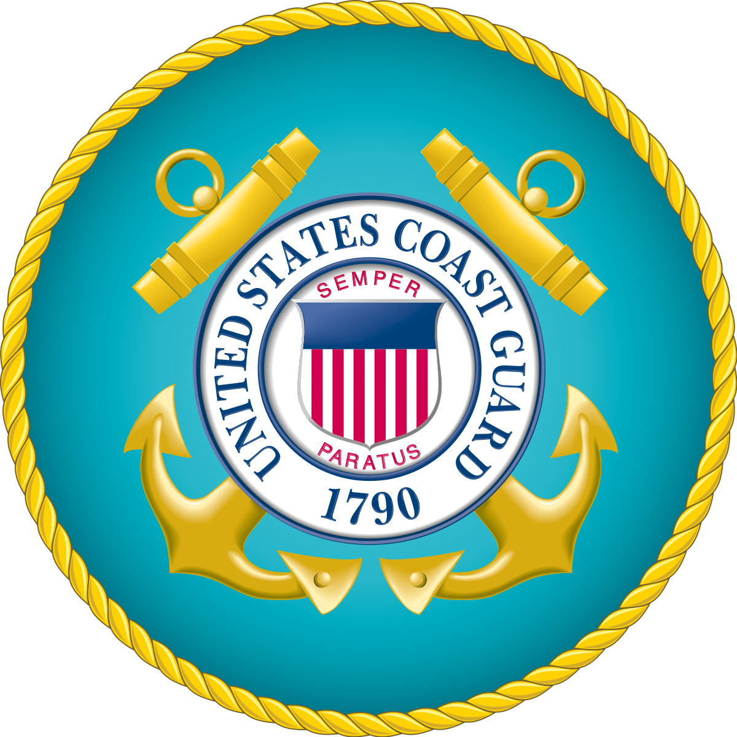
Please Welcome our USCG Keynote Speaker,
Mike Emerson
ADAC Year 8 Annual Meeting, 20-21 April
Michael D. Emerson, Director Marine Transportation Systems Management (CG-5PW), U.S. Coast Guard
ADAC: Research for the Arctic Operator… For Today and For the Future

Slide 4
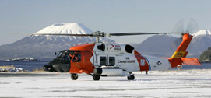
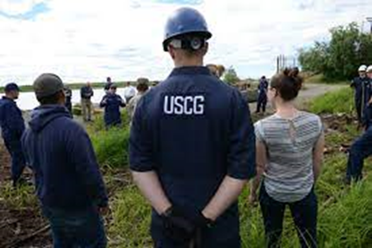
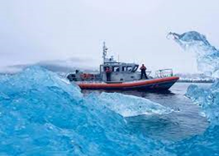
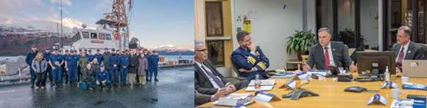
ADAC Year 8 Annual Meeting
...Via Conference Call, 20-21 April 2022
ADAC Center Overview of Projects
Briefing
Jeff L. Libby, Executive Director, University of Alaska Anchorage
Heather L Paulsen, Finance Director, University of Alaska Anchorage

Slide 5
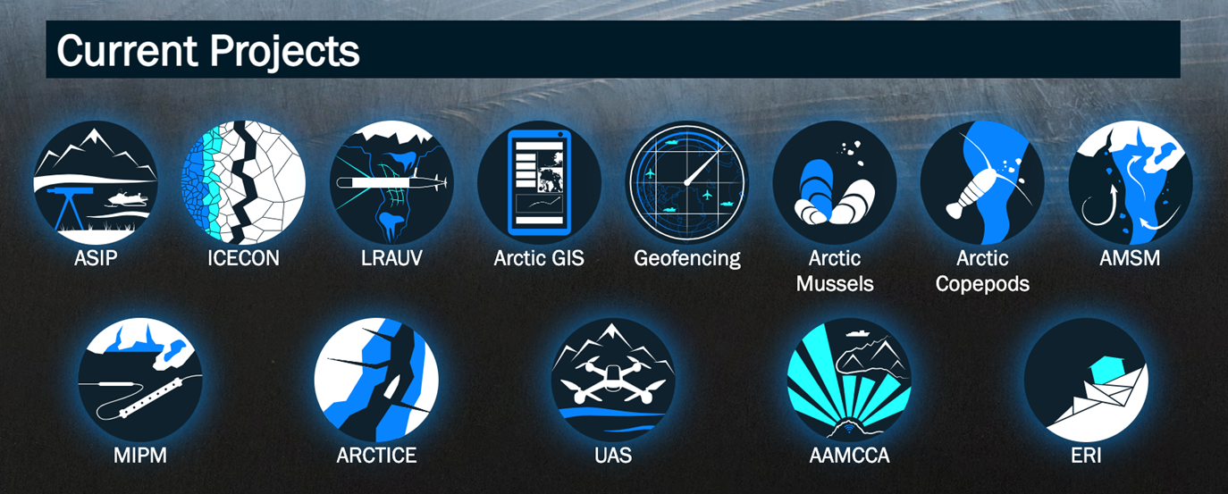
ADAC’s S&T Research Projects
ADAC Program Year 8 Annual Meeting

Slide 6
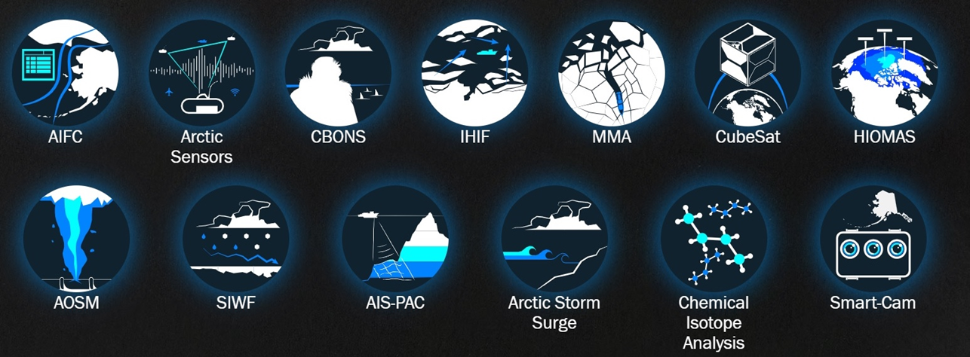
ADAC’s Completed S&T Research Projects
ADAC Program Year 8 Annual Meeting

Slide 7
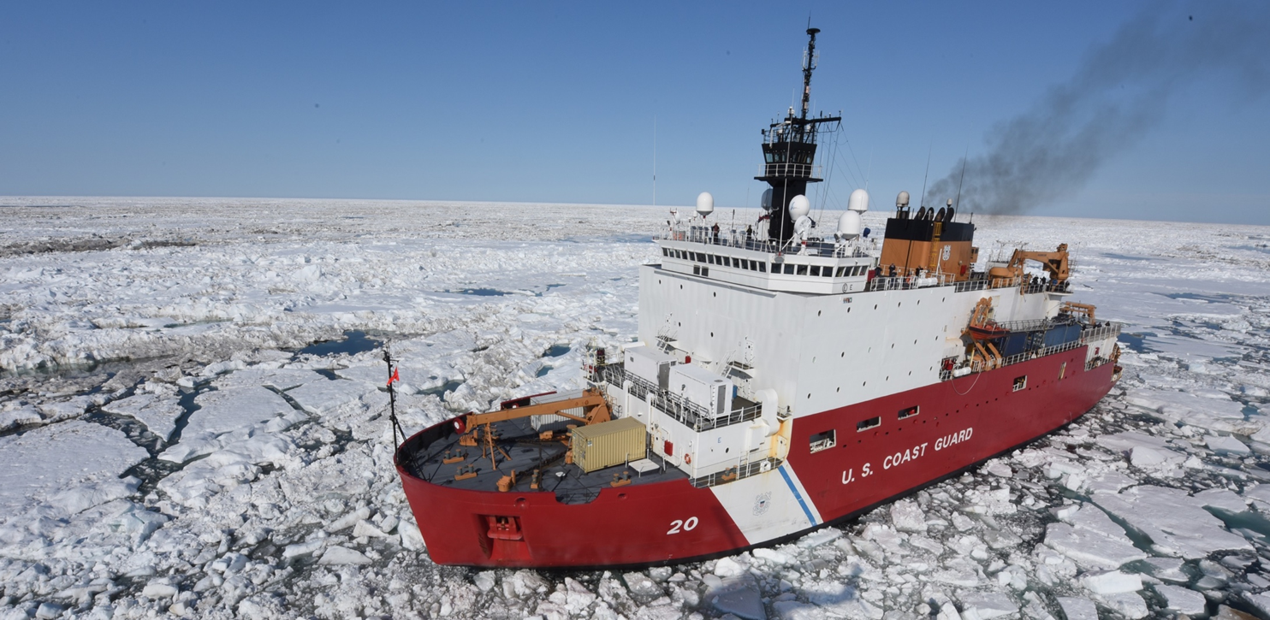
ADAC Project Summary Details
ADAC Program Year 8 Annual Meeting

Slide 8
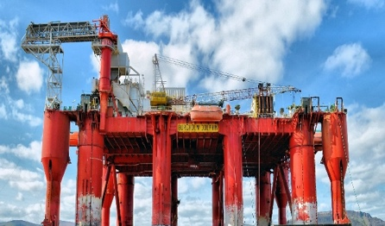
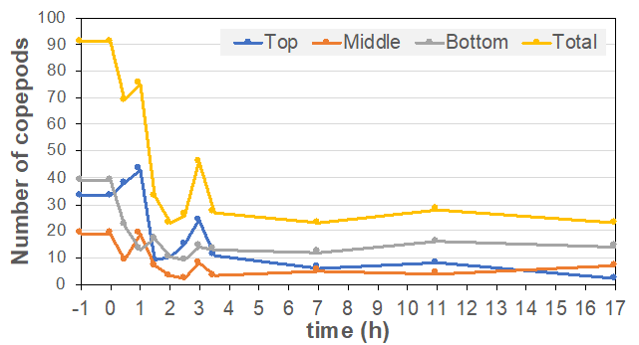
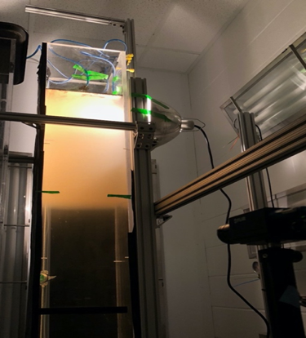
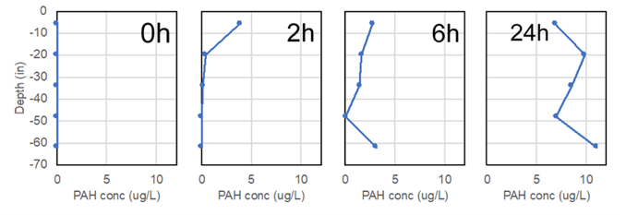
Mitigating the Damage to Arctic Copepods from Surface Oil Spills: When to Apply Dispersants
ADAC Program Year 8 Annual Meeting
Project Description:
Copepods are tiny oceanic crustaceans that not only occupy an extremely vital niche in ecological food chains, but can serve a role as biodiversity indicators as well. This project’s goal is to determine if Arctic Calanus copepods can spatially separate themselves from surface oil spills during portions of their developmental cycle. The primary benefit to stakeholders is a greater understanding of how oil spills and dispersants impact copepods.
Project deliverables/Transition:
Technical reports with all results of the research, delivered to USCG and DHS.
Three peer-reviewed publications, addressing each of the phases and objectives individually.
Make all data produced during this project publicly available at the Knowledge Network for Bio-Complexity data repository.
FOSC Crisis Response Guide
Phase 1:
Determine whether C. finmarchicus copepods actively avoid oil or dispersants
Phase 2:
Investigate dispersant influence on subsurface wildlife exposure to oil products
Phase 3:
Determine how water column stratification and light affect contact between copepods and oil
An example of PAH concentrations (ug/L) over depth (in), 0 hr., 2 hr., 6 hr., and 24 hr. after introduction of fresh crude oil (ANS).

Slide 9
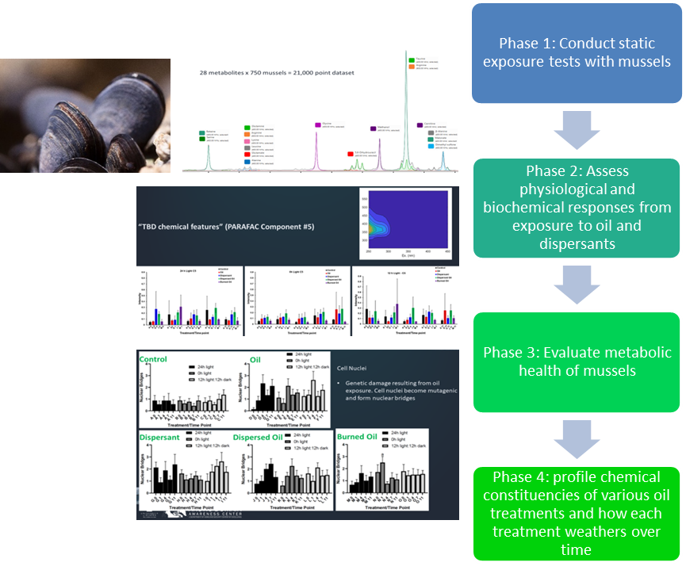
Photo-enhanced toxicity of dispersed and burned Crude Oil to Arctic Mussels
ADAC Program Year 8 Annual Meeting
Project goal:
To determine whether dispersants or in-situ burning has a greater effect on Arctic mussel toxicity, and whether extreme seasonal differences in sunlight affect acute sublethal response.
Project deliverables:
Knowledge product publishing the research conducted, analysis, conclusions and recommendations.
The published works will also include peer-reviewed scientific article(s)
Researchers will create a weighted Pugh concept selection matrix. Project personnel will perform concept selection and identify relative criteria weights.
Transition: Knowledge Products for USCG and Publications to Peer Review Journals supporting Oil Spill Research. New Summary Guide as well for FOSC in crisis response

Slide 10
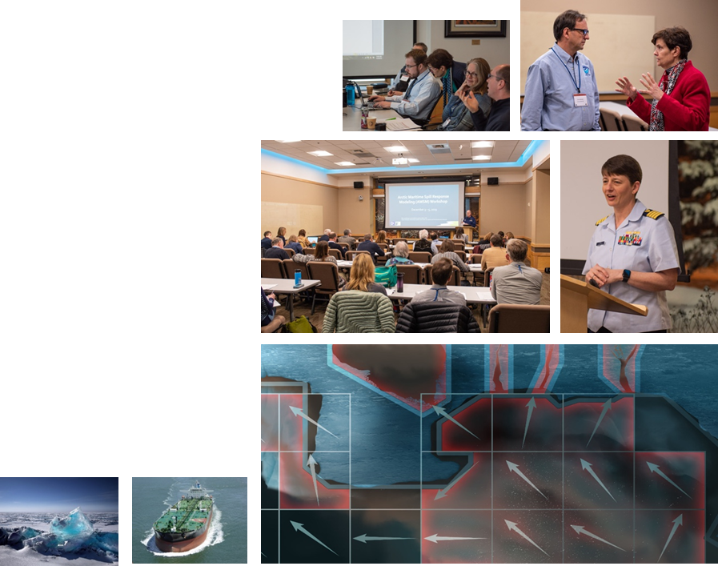
Oil Spill Modeling for Improved Response to Arctic Maritime Spills: The Path Forward
ADAC Program Year 8 Annual Meeting
ADAC’s research seeks to provide practical solutions for operators. Scientific research sometimes provides divergent solutions – i.e., using one specific approach to examine the effects on an overall system.
The goal of this project is to provide a path forward to improving Arctic oil spill response models by using convergent solutions – how to improve an overall system by potentially incorporating multiple approaches.
Project uses workshops and working groups of cross functional experts in oil spill modeling.
Project deliverables/Transition:
This project will result in a knowledge product describing:
1. Specific needs and questions that must be addressed by Arctic oil spill response models;
2. Current state-of-the-art Arctic oil spill models available;
3. State-of-the-art Arctic oil spill response model utility in response modeling;
4. Components from recent research efforts (e.g., Gulf of Mexico Research Initiative (GOMRI) useful for incorporation in order to improve current Arctic spill response models.

Slide 11
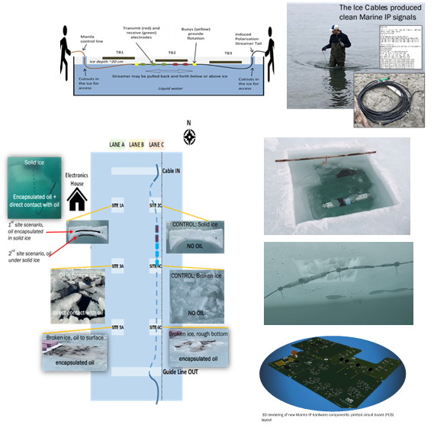
Marine Induced Polarization Methods for the Detection and Mapping of Oil in an Arctic Marine Oil Spill; Including Investigation of Oil Within and Under Broken Ice Fields
ADAC Program Year 8 Annual Meeting
Marine Induced Polarization (IP) is a USGS-patented technology that takes advantage of material properties to sense subsurface materials, such as oil trapped in ice.
In IP, a voltage is adsorbed (adhered to the surface of a material) through electrodes placed in the ground.
A different set of electrodes measures subsurface electric resistance and capacitance. All materials have unique resistive and capacitive properties.
Measuring subsurface capacitance and resistance enables identification of possible subsurface materials.
Detecting location of trapped oil within or under broken ice fields greatly improves Federal On-Scene Coordinator decision-making capability.
Planned research seeks to understand the ability of Marine IP to characterize the nature and mapping of Arctic oil spills, thereby honing ability to conduct effective oil spill responses.
Project deliverables/Transition:
The outcome of this research will be
A series of knowledge products (technical reports and supporting data) that may demonstrate Marine IP technology can be effectively utilized in the Arctic environment.
Marine Ready IP Kit as a prototype for rapid use in a crisis response spill

Slide 12
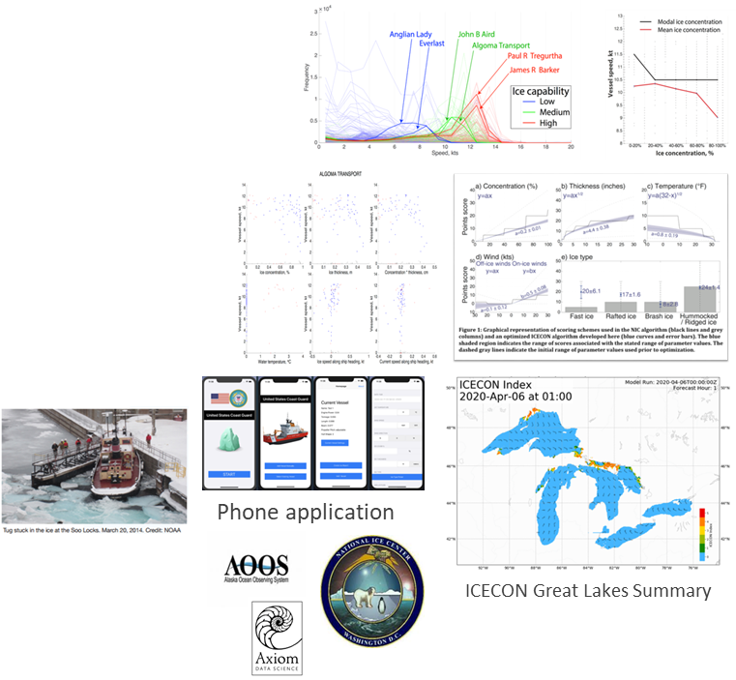
Ice Conditions Decision Index for the Great Lakes region
ADAC Program Year 8 Annual Meeting
Project Goal:
ADAC researchers are finalizing an ice condition index (ICECON) for the Great Lakes for USCG operators and lake mariners, which uses available data to forecast ICECON up to 3 days into the future. This enhances ship safety, potentially reducing number of icebreaker deployments for rescuing vessels entrapped in ice.
With ice parameters collected by USCG and Canadian Coast Guard crews operating in the Great Lakes in the 2016-2020 time frame, the team has advanced Monte Carlo simulations to determine the most predictive relationship between the ice parameters and ICECON.
The team is also using ice data from the 2013-2020 period in conjunction with AIS data to determine which parameters affect vessel speed and are important to ICECON.
Researchers continue to pull nowcast and forecast data in real-time (every 6 hours), compute the ICECON nowcast and forecast, and display it on a project website…currently using Canadian Ice Services Environmental data.
Transition: USNIC projects ICECON Via AOOS & Axiom Data Science Computation.

Slide 13
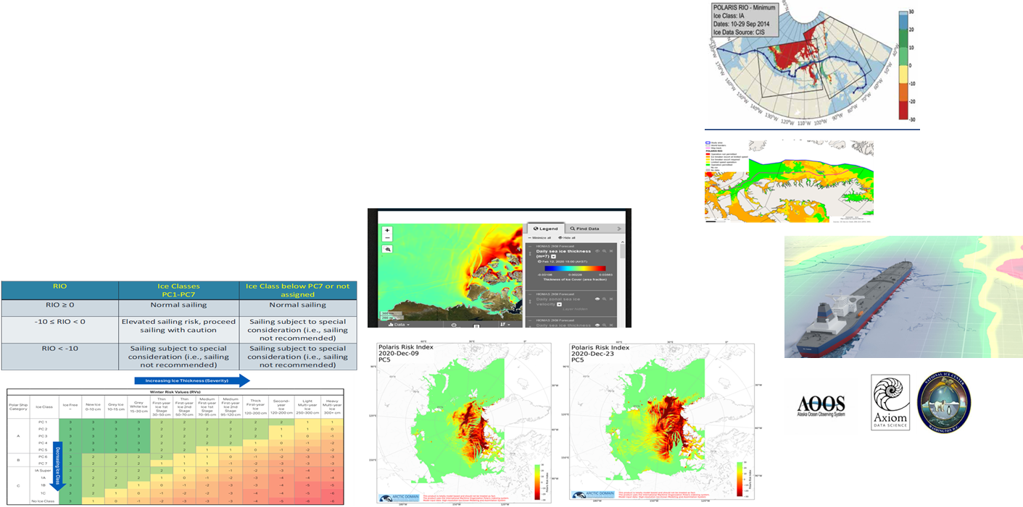
Arctic Ice Condition Index (ARCTICE)
ADAC Program Year 8 Annual Meeting
Project Description: ARCTICE produces an easy-to-understand numeral to communicate ice conditions that are relevant to the capabilities of an individual vessel. This index will be available for current and future ice conditions, providing forecasts up to 72 hours in advance. Based on prior Great Lakes ICECON investigations, research will provide marine operators a transition destination ready access to this information (such as the U.S. National Ice Center...USNIC) supporting vessel captains in route planning and determining associated risk with traveling through a particular region in Arctic Waters.
Broad area, low resolution idealized chart for ARCTICE output
High resolution/low area idealized chart for ARCTICE output
Currently leveraging HIOMAS for environmental factors

Slide 14
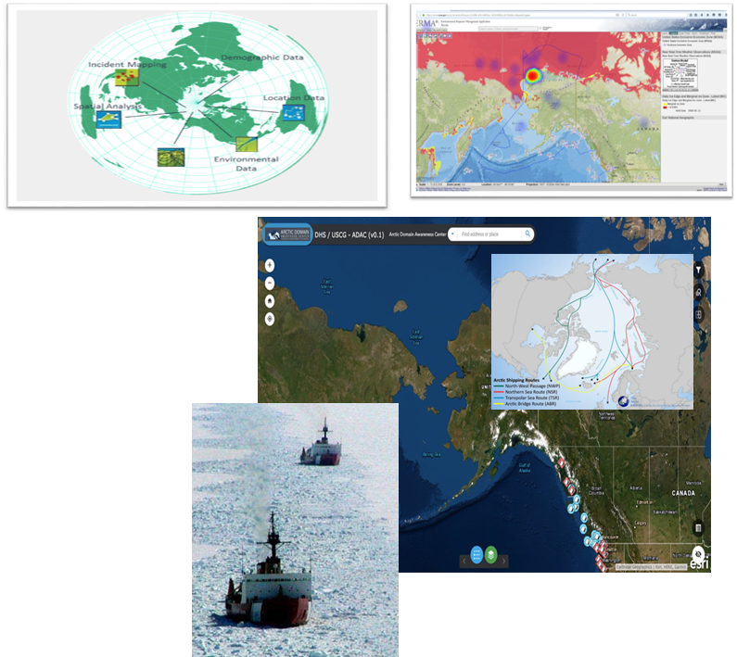
Arctic Domain All-Hazards WebGIS
ADAC Program Year 8 Annual Meeting
Project goal:
To assist and enhance U.S. Coast Guard domain awareness by developing an Arctic All-Hazards webGIS product built within the DHS Geospatial Information Infrastructure and the Homeland Security Information Network.
The All-Hazards project seeks to improve usability, interoperability, and function by developing the webGIS geo-visualization product.
Project phases:
Phase 1: Interviewing, survey and research brief
Phase 2: Data acquisition and development of web application
Phase 3: Alpha Release
Phase 4: Beta Release and user guide
Phase 5: Go Live and Final Delivery
Phase 6: Final Usability Report
Phase 7: Submit peer-reviewed publication
Transition: Test application with USCG uniformed and civilian staff during alpha and beta testing, then house Arctic All-Hazards WebGIS within the GII/HSIN.

Slide 15
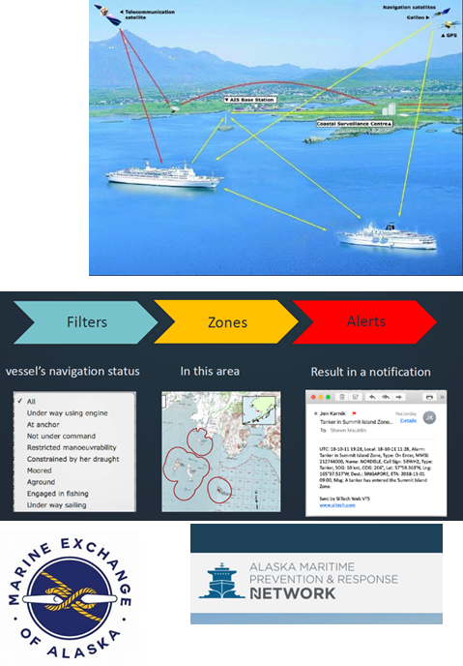
Arctic Vessel Monitoring Geofencing/ Alert Awareness
ADAC Program Year 8 Annual Meeting
Advance Arctic Maritime Domain Awareness and Management by boosting the development and implementation of automated geofencing alerts to the U.S. Coast Guard to enhance maritime safety, security, environmental protection, and vessel regulatory compliance in U.S. Arctic Waters.
Two prong effort: 1. PACTRACS (for commercial mariner community) via Alaska Marine Exchange 2. USCG “CGOneView” for USCG operational watch standers
Geofences can be customized by the end-user to meet agencies requirements.
Have multiple filters and GIS overlays to better discriminate vessel type and activities.
GIS files importable and exportable by end-users.
Alerts and notifications can be received on multiple unclassified platform devices by government agencies.
Geofence/alert notifications sent to Social Media/email platforms for other Federal/State agencies and Arctic stakeholders.
Coastal Communities receive tailored notification and alerts.
Supports: U.S. Coast Guard, State of Alaska, and the maritime industry within the U.S. Arctic Exclusive Economic Zone
Transition: PACTRACS version completed and mid-way for developing CGOneView edition in coordination with HQ USCG.

Slide 16
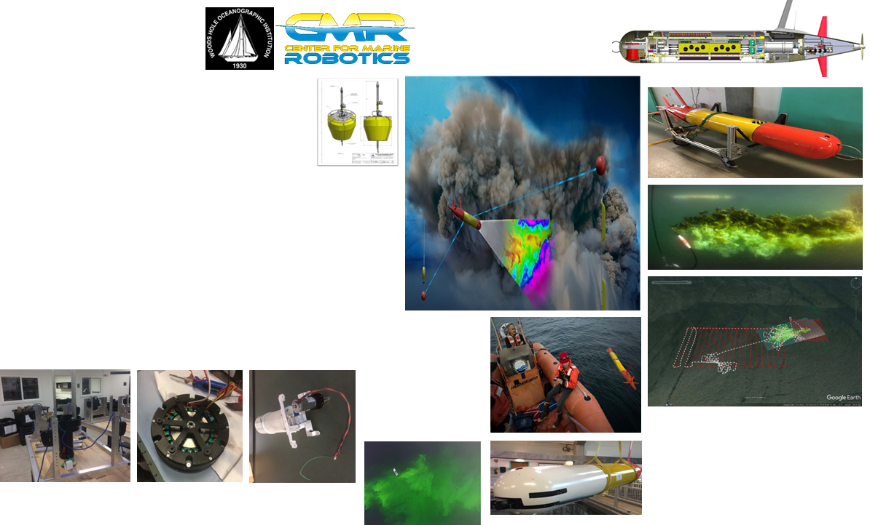
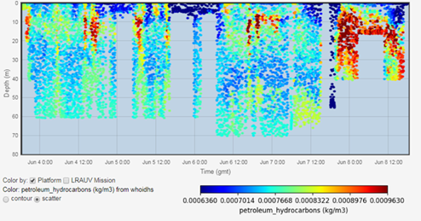
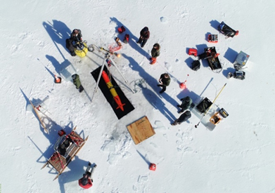
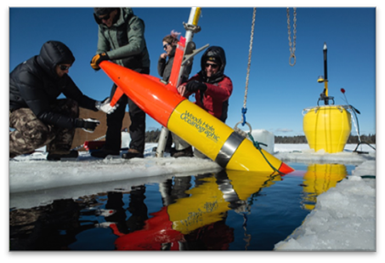
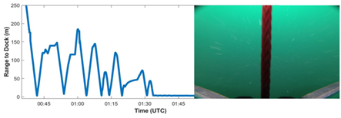
Propeller Driven Long Range Autonomous Underwater Vehicle
ADAC Program Year 8 Annual Meeting
Project Description:
LRAUV is helicopter portable, carrying an environmental mapping payload which allows rapid response to provide situational awareness and damage mitigation for first responders/USCG.
Initial Capabilities (expandable):
Ability to map in 3D.
Extended unattended deployment (days to weeks).
600 KM range…under ice.
Detection and quantification of dissolved particles and fluorescent material (with current sensor package).
Environmental characterization.
Transition: CG-926, USCG RDC & or Commercialization.

Slide 17
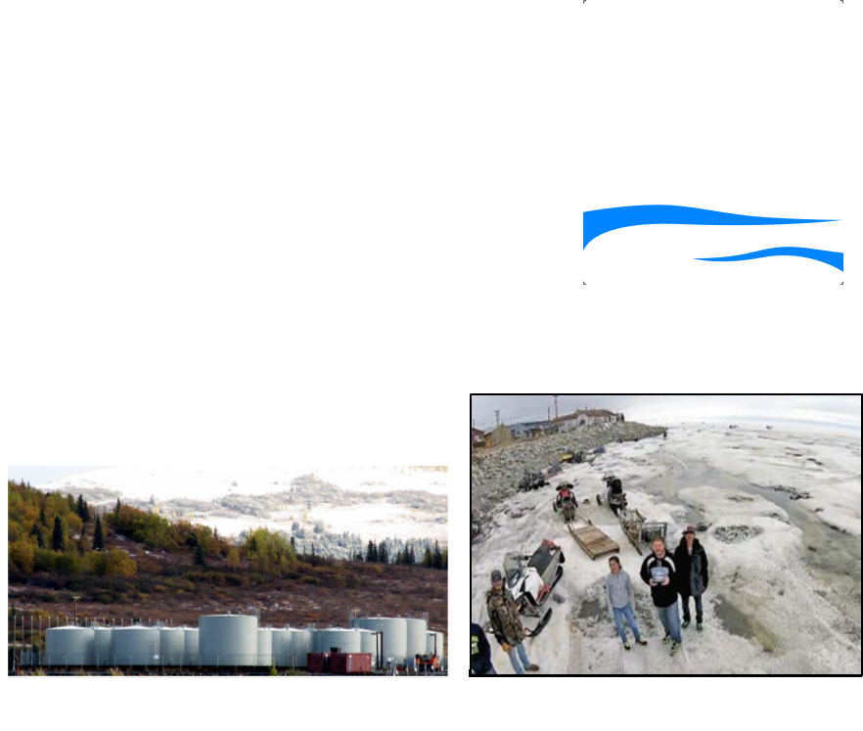
Remote Unmanned Aircraft System (UAS) Inspection and Response Team Development in the Bering Strait Region
ADAC Program Year 8 Annual Meeting
This program will develop a trained pilot team (planned at five individuals) within the community of Unalakleet, versed in the operation of off-the-shelf U.S. made UAS technologies.
    Project goals:
Create a knowledge product providing analysis of experiments using multispectral sensor capacity to support infrastructure monitoring
Co-produce a UAS-based monitoring program focused on USCG regulated bulk fuel facility inspections and emergency response, with the Alaska Native Village of Unalakleet
Understand the feasibility of expanding the developed monitoring program to communities throughout the Norton Sound region to effectively support CG facility inspections and the response efforts in remote western Alaska
Determine if this project can be used as a roadmap for that expansion

Slide 18
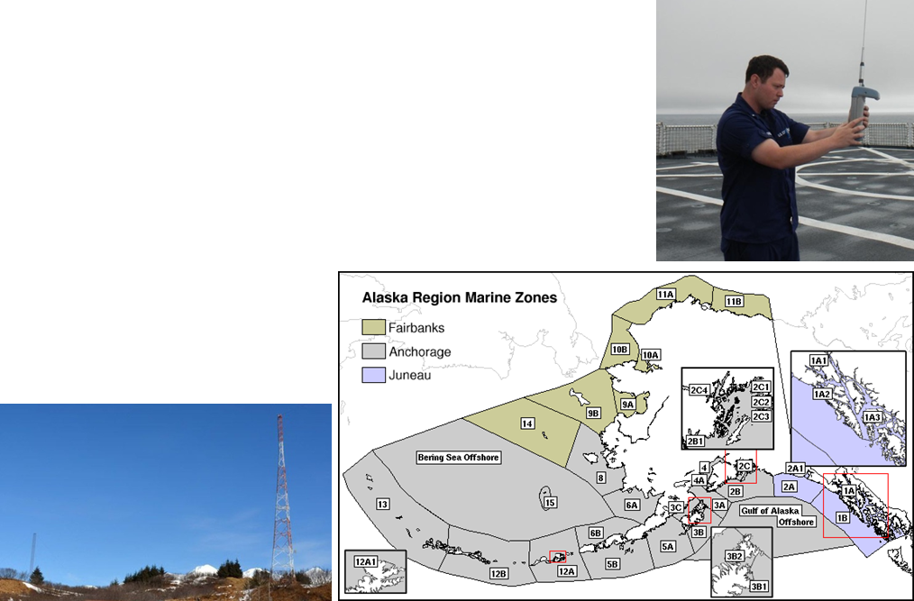
Alaska and Arctic Maritime Communications and Connectivity Analysis (AAMC&CA)
ADAC Program Year 8 Annual Meeting
Project Description: This project provides a comprehensive review of mariner communications and connectivity mission needs for the Alaska and the U.S. Arctic Extended Economic Zone (EEZ), with a particular focus on the Arctic (based on near, mid-term, and long-term time horizons)
The knowledge product will contain:
Comprehensive review of mariner communications and connectivity needs for the Alaska and the U.S. Arctic Extended Economic Zone (EEZ)
An updated and expanded market survey current communications technology
A geographic review of communications/ connectivity shortfalls
A technology-focused review of known/understood existing capabilities, assessed against researched gaps for the high latitudes
An expert-derived set of options and recommendations

Slide 19
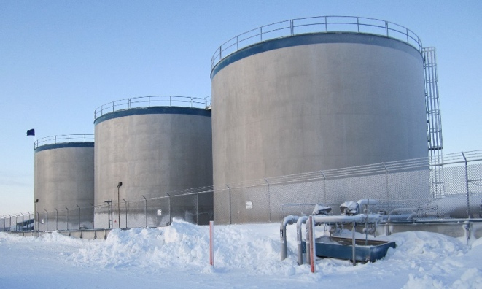
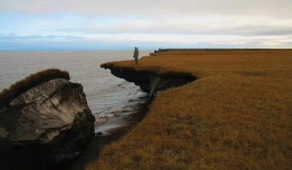
Arctic Facilities and Infrastructure Environmental Change Index
ADAC Program Year 8 Annual Meeting
This project provides the U.S. Coast Guard an “Arctic facilities and infrastructure environmental change” risk index, training guide, and comprehensive knowledge product to inform U.S. Coast Guard operations and inspections in order to manage inspection and response decision risk in a rapidly changing Arctic environment.
Objective/Purpose.
This project will address direct concerns regarding structural risks of facilities and infrastructure in Arctic Alaska due to cumulative effects of environmental change.
Based upon analyzing these concerns, this research will address two principal questions:
What are the risks and severity to USCG monitored facilities along the Arctic coastal regions of the Bering, Chukchi and Beaufort Seas?
What are the risk weightings related to the USCG monitored facilities along the Arctic coastal regions?
Drew Point, Alaska Photo from USCG.gov
Bonanza Fuels, Nome, Alaska Photo from AIDEA.org
Project outcomes for the research:
Synthesize published literature, existing data from available sources, USCG infrastructure and incident reporting, and consolidate expert opinion to establish a baseline knowledge project in support of USCG Project Champion and USCG Project stakeholders. This information will guide and inform the project’s interdisciplinary workshops and focused working groups Examples provided: Alaska District U.S. Army Corps of Engineers, State of Alaska Department of Environmental Conservation, Denali Commission, University of Alaska Fairbanks Institute of Northern Engineering, Associated State of Alaska Boroughs, Ports and Villages associated with USCG designated infrastructure and facilities of concern and others as determined by the research team and established project research groups.

Slide 20
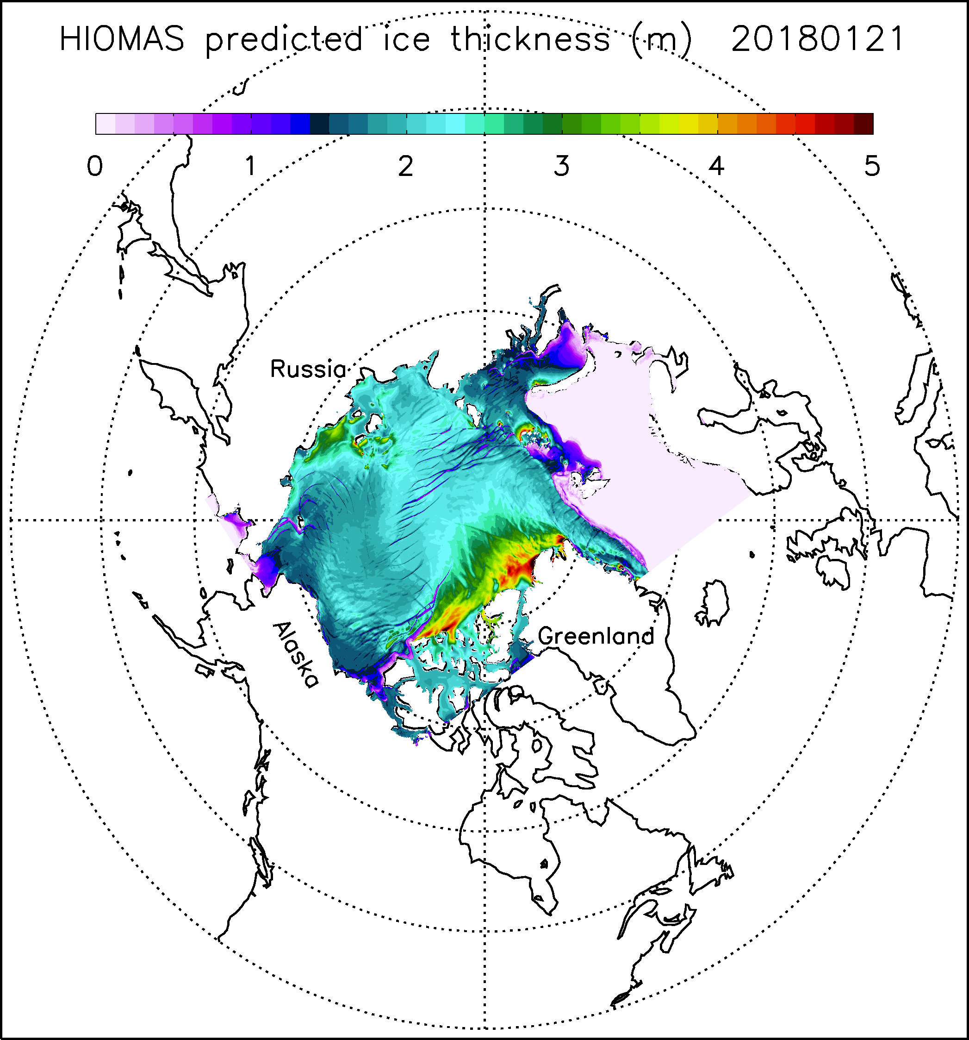
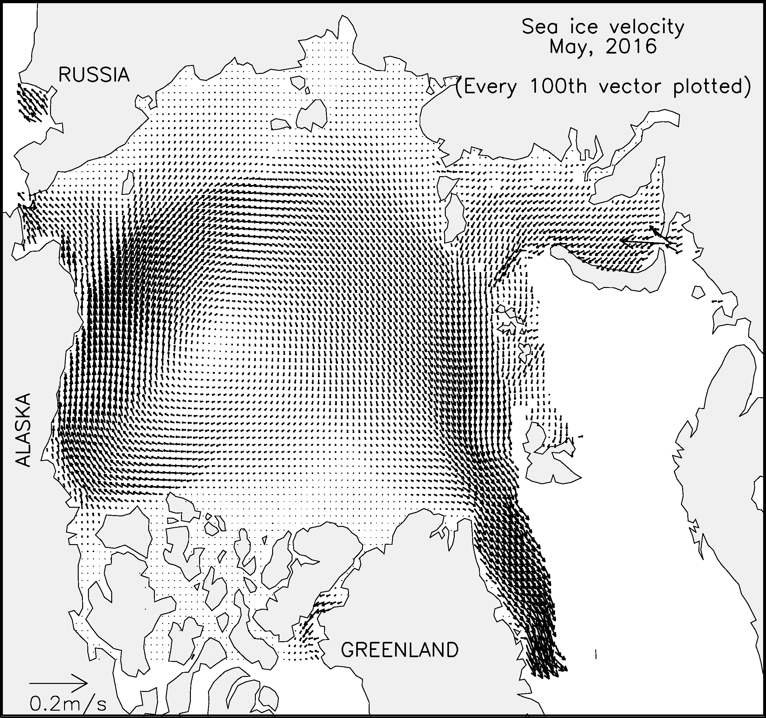
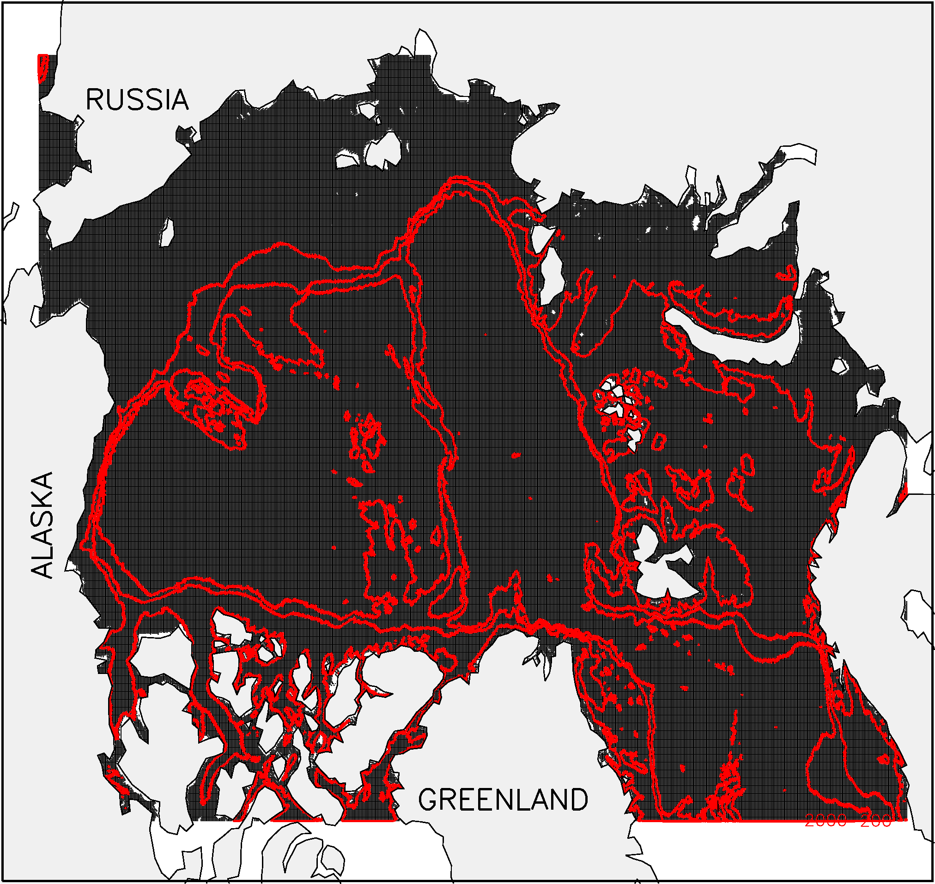
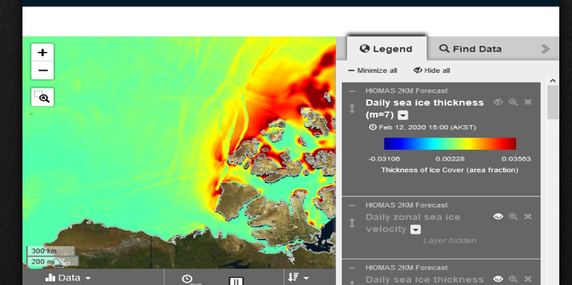
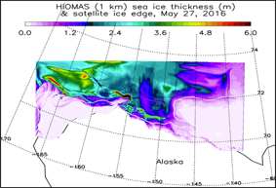
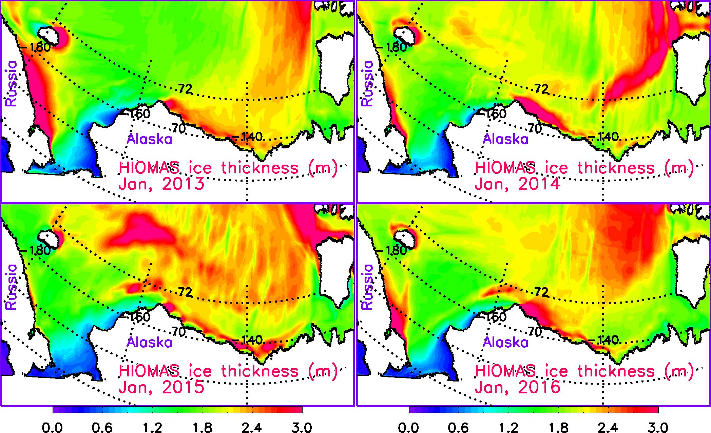
High resolution Modeling of Arctic Sea Ice and Currents
ADAC Program Year 8 Annual Meeting
HIOMAS (High-resolution Ice-Ocean Modeling and Assimilation System)
A forecast system that can distribute the forecast data to the Coast Guard and other Arctic stakeholders.
Developed 3 versions of HIOMAS with 6, 4 and 2 km horizontal resolutions. Now 24 Factors of detail!
Assimilate satellite sea ice concentration in HIOMAS hindcast to improve initial conditions for forecast.
Calibrated and validated HIOMAS hindcast using sea ice observations; no excessive ice thickness buildup in areas such as the Beaufort Sea.
Conducted (near) real-time hindcast and daily to seasonal forecast of Arctic sea ice and currents.
Prototype 1 KM resolution version for the US. EEZ for Bering, Chukchi and Beaufort Seas
Publishing…Bi-weekly, 7 Day Hindcast, 30 Day Forecast
2 km resolution Pan Arctic HIOMAS
Ice ridges above and month to month planning below…
1 km resolution HIOMAS…US Arctic EEZ
Transition: Completed to AOOS and Axiom Data Sciences as destination to publish to NOAA, NWS, & US National Ice Center

Slide 21
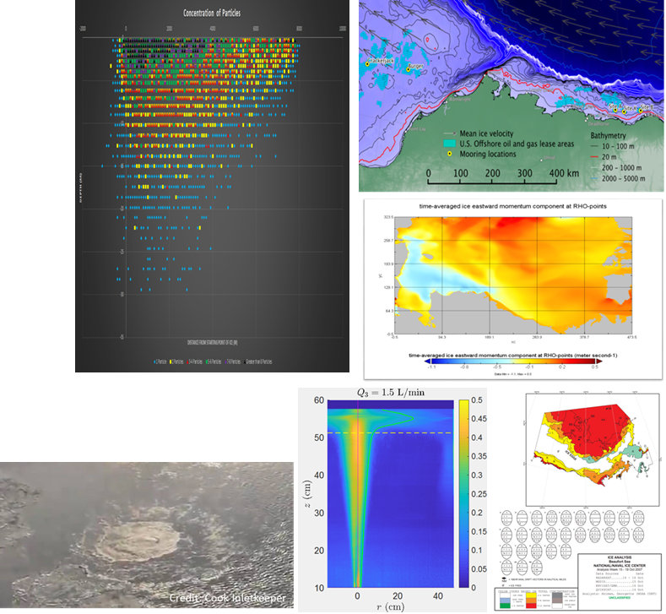
Arctic Oil Spill Modeling (AOSM)
ADAC Program Year 8 Annual Meeting
Project assists U.S. Coast Guard and the NOAA Office of Response and Restoration with the development of an Arctic-capable oil spill model that can be leveraged via NOAA’s General NOAA Operational Model Environment (GNOME).
Worked with NOAA to develop a new variable within GNOME: under-ice storage capacity.
Ice storage capacity has been estimated at several locations in the Chukchi and Beaufort Seas, based on ice draft data.
Provided 3 D model support for LRAUV.
Improving integration of TAMOC with GNOME to include all oil fate processes.
Training with NOAA staff to use TAMOC and AOSC algorithms within GNOME.
Capable of “On-demand” support (such as Cook Inlet Methane Leak).
Transition: Completed to NOAA’s GNOME.

Slide 22
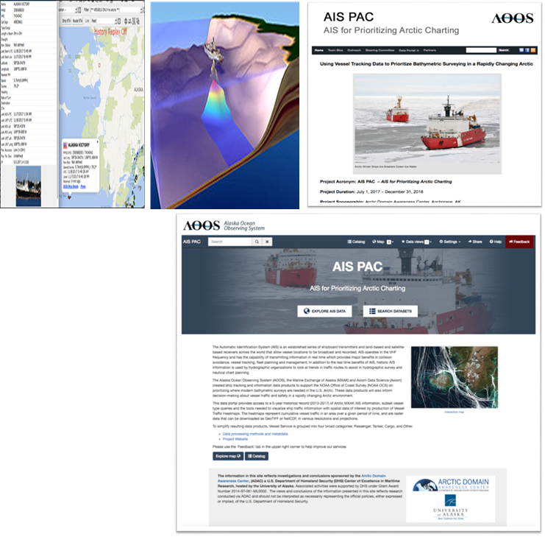
Using Vessel Tracking Data to Prioritize Bathymetric Surveying
ADAC Program Year 8 Annual Meeting
Project creates products that inform decision-making about vessel traffic and vessel safety in a rapidly changing Arctic environment.
The research effort is develop the capability to reduce execution time for handling and analyzing exceptionally large collections of Automated Information System (AIS) vessel tracking data.
A large data analytics effort.
Gridded files provide the extracted AIS information needed for decision makers and stakeholders in the U.S. Arctic area.
Transition: Completed: A set of knowledge products useful for USCG and NOAA to apply to survey/mapping efforts for Alaska (including Arctic Alaska). Now being leveraged for NOAA Summer Bathymetric Surveys
AOOS AIS-PAC Completed Project Webpage: http://aoos.org/ais-4-bathy/

Slide 23
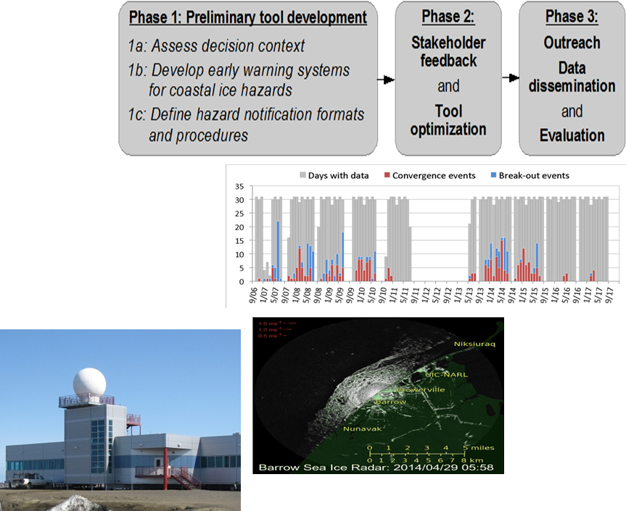
Crisis Response Sea-Ice and Weather Forecasting tools
ADAC Program Year 8 Annual Meeting
Research project strives to improve USCG and other DHS Arctic maritime operator situational awareness and crisis response by enhancing support for planning and emergency response to meteorological and environmental marine hazards in the Arctic.
Literature Reviews and interviews with a host of marine operators.
Identification of hazardous ice events using coastal radars:
  Ice Convergence,
  Landfast ice breakout, and
  Anomalous ice motion.
Transition: Researchers developed decision support tools, grounded in stakeholder interactions, to support weather and sea ice-sensitive decision making. Developed a prototype with software and hardware in the Barrow region. Provided prototype observations provided via AOOS to NOAA/NWS Observations. Established working prototype at Barrow Arctic Research Facility in conjunction with UAF and Sandia National Labs

Slide 24
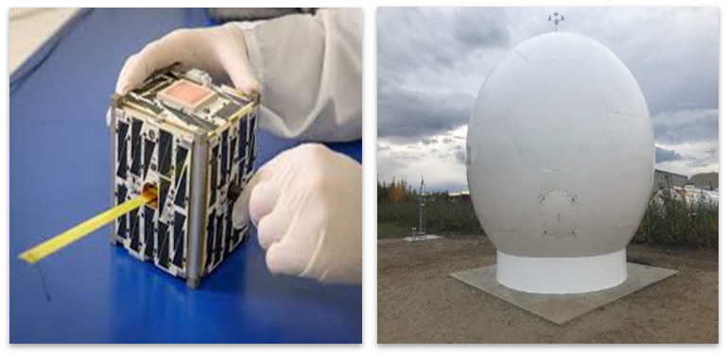
Exploring Enhancements to Arctic Communications and Domain Awareness using the ASF CubeSat Antenna Farm Experiment (CAFE)
ADAC Program Year 8 Annual Meeting
Project is direct USCG award, that partners ADAC and University of Alaska Fairbanks’ Alaska Satellite Facility to conduct cube satellite research in support of USCG Arctic Communications shortfall research via a Mobile CubeSat Command and Control (MC3) antenna system and radome at the Alaska Satellite Facility. Research will increase USCG knowledge on Arctic communications and viability of Cube satellites to improve maritime communication in Bering, Chukchi and Beaufort Seas.
Transition: Depends on directions from HQ DHS S&T.
4 Dec 2019: Satellites Kodiak and Yukon deployed on Polar Low Earth Orbit...Kodiak functioning in accordance with plan, but while Yukon initially functioned, communications was lost shortly following first contact.
However, experiment is considered a success.

Slide 25
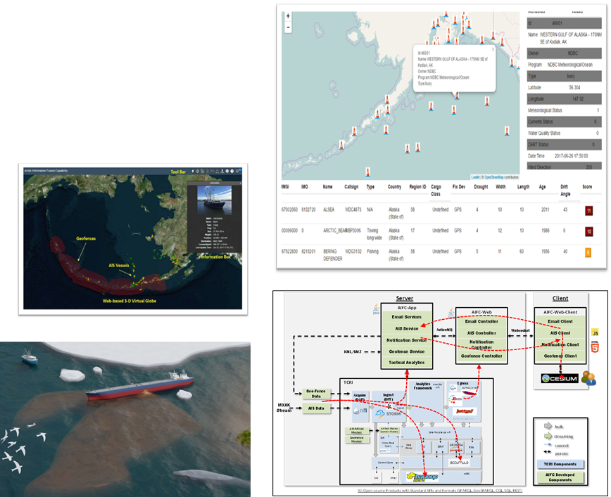
Arctic Information Fusion Capability
ADAC Program Year 8 Annual Meeting
The Arctic Information Fusion Capability (AIFC) project supported operational decision makers in the maritime domain ranging from operational commanders, to tactical operators, to community-based observers.
AIFC fused together a wide array of near real-time, high resolution data sources into a cohesive and easy to understand interface.
The project took in satellite imagery, environmental models, local sensors, web-based communications, and appropriate social networking feeds to gain domain awareness in support of operational decision making by responders in the field.

Slide 26
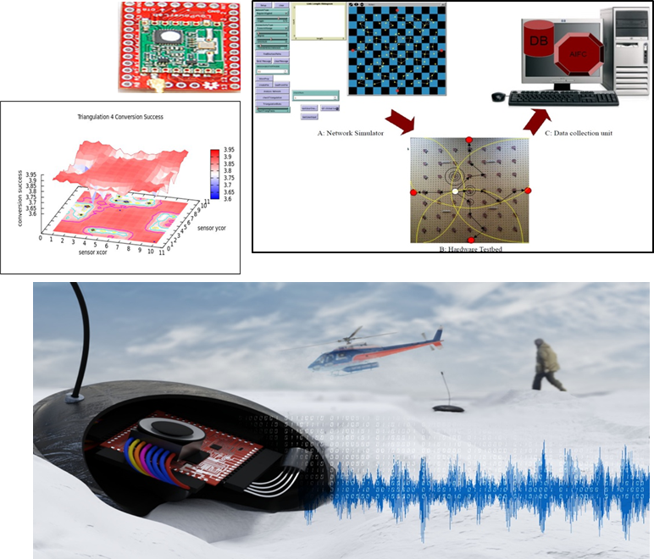
Low-Cost Wireless Remote Sensors for Arctic Monitoring and Lifecycle Assessment
ADAC Program Year 8 Annual Meeting
The Arctic is hard to constantly monitor. In order to resolve this problem, low-cost wireless sensors were developed to detect an input event, analyze detected events, and communicate that event data to other sensors in the network.
These inexpensive, self-organizing network devices reliably computed and communicated detected human, animal, and environmental events. By utilizing a variety of sensors, it was possible to detect sounds, vibrations, radio and cellphone signals, location, and more based upon the needs of each sensor.
When implemented, the project would have provided a quick method to deploy and monitor an Arctic region. Potential uses were events such as ice breakup, environmental events, model validation, vehicle detection in regions of concern, or even assisting with the safety monitoring of personnel and equipment during training exercises.

Slide 27
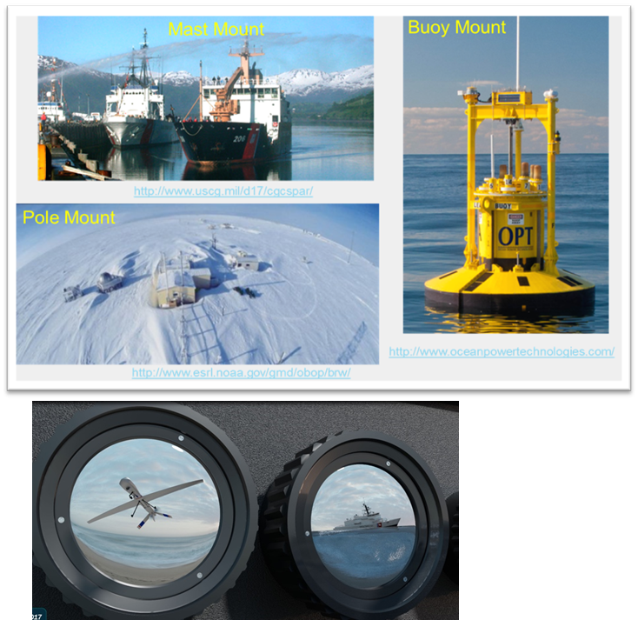
Smart-Cam Computational Photometer
ADAC Program Year 8 Annual Meeting
The goal of this project was to construct a proof-of-concept visible two channel (optional visible + long wave infrared multispectral) camera proof of concept to be tested at the Port of Anchorage. The proof-of-concept was to be constructed using all off-the-shelf hardware components and used to form a baseline of comparison for the longer-term Computational Photometer (“Smart-Cam”), for a longer-term goal of the research, for Arctic operations with drop-in-place multi-spectral and stereo vision cameras.
From the proof-of-concept it was expected that challenges of long-term battery operations, drop-in-place packaging for Arctic environments, and power efficiency and methods to recharge can be better understood for follow-on phases.
Potential uses were for oil detection under ice in an AUV and tracking and detecting vessels, animals, and people in fog and ice environments typical of the Arctic.

Slide 28
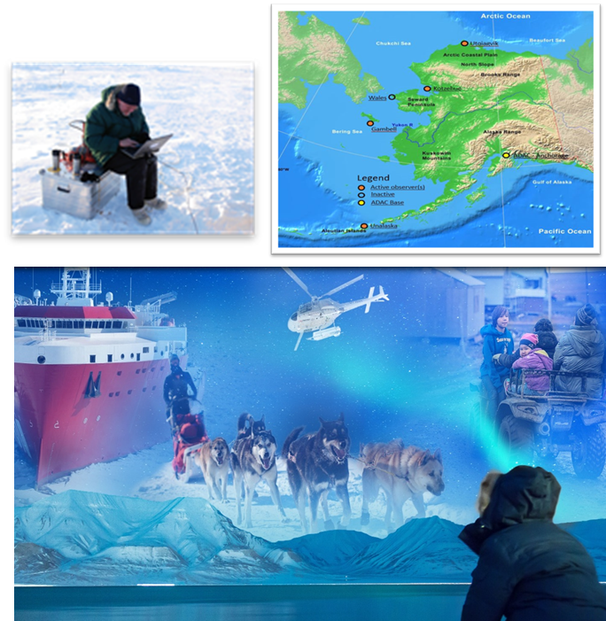
Community Based Observer Networks for Situational Awareness
ADAC Program Year 8 Annual Meeting
This project established a community-based observing network and system (CBONS) to acquire fine scale, local data on a range of variables critical to USCG operations. It was developed to enhance the Coast Guard’s ability to successfully respond to Arctic-related Incidents of National Significance (Arctic IoNS).
Variables were associated with environmental change, subsistence activities/habitats and vessel transits. CBONS data was then used to enhance the preparedness of communities on the ground, leading to increased effectiveness of USCG in the Arctic and reduced long-term costs.
The project also generated community maps consisting of areas critical to culture and subsistence, allowing the Coast Guard to operate in ways that protect livelihoods and traditional lifeways. Finally, CBONS data are potentially useful to enhance the precision of data from other Arctic Observing Networks (AON) by placing them in situational contexts.

Slide 29
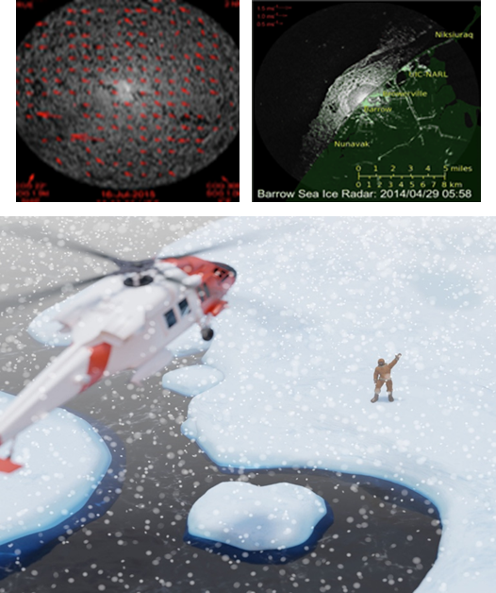
Identifying, Tracking and Communicated Sea-Ice Hazards in an Integrated Framework
ADAC Program Year 8 Annual Meeting
Increasing shipping and offshore activity together with emerging climate change-related threats to coastal and marine infrastructure related to traffic have greatly increased threats to environmental security in the maritime Arctic. In order to minimize and manage risks, hazards need identification and tracking. This project focuses on those hazards associated with ice in the ocean such as entrapment of vessels; structural damage to vessels and infrastructure; and risks to personnel and assets due to detachment of landfast ice.
During an Arctic emergency response, assets need safe and effective deployment in regions that are often remote and challenging. Involvement of local first responders will be a critical part of any Arctic response. Therefore, responders need a framework at the local scale to enhance and inform Arctic MDA and emergency response by identifying, tracking and communicating key environmental hazards in ice covered extreme maritime environment.
Predicting the real-time ice velocity from Utqiaġvik (formally Barrow), Alaska will improve capabilities for ice hazard monitoring. As the northernmost point in the North American mainland, Point Barrow is often the last location along the Alaska coastline to open up to navigation and therefore represents a potential chokepoint for maritime operations in the U.S. Arctic. Making real-time data available to analysts will improve the ability of decision makers to assess hazards posed by sea ice in this location. Additionally, the project team demonstrated that the technology developed to track ice motion is transferrable to ship-based platform, where it is potentially useful to provide tactical information about ice conditions to crew.

Slide 30
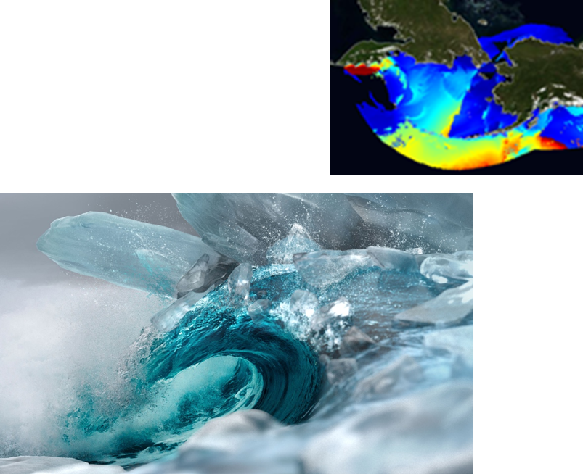
Real-Time Storm Surge and Coastal Flooding Forecasting for Western Alaska
ADAC Program Year 8 Annual Meeting
University of Alaska Anchorage (UAA) developed a high-resolution storm surge model for the Yukon-Kuskoswim Delta area to provide high-resolution forecasts of storm surge and coastal flooding for vulnerable coastal communities in Western Alaska.
In addition to flooding, the model also predicts thirty-one associated ecological impacts, assuming different sea level rise scenarios. The storm surge modeling was conducted with Delft3D software.
The ocean boundary of the storm surge model was “forced” by real-time and forecasted water level data generated by National Weather Service’s Extra Tropical (ET)-Storm Surge model. In addition, we developed a hindcasting storm surge model for the Norton Sound.
The model was forced on its ocean boundary by output from a course grid ADCIRC storm surge model developed by the U.S. Army Corps of Engineers.
The Delft3D and SWAN models were used for the storm surge and wave modeling, respectively. The ocean boundary of the SWAN wave model came from nowcasts and forecasts from NOAA’s Wavewatch III wave model. The model wave calibrated and validated using nearshore water level data and using satellite observations of inundation extent.

Slide 31
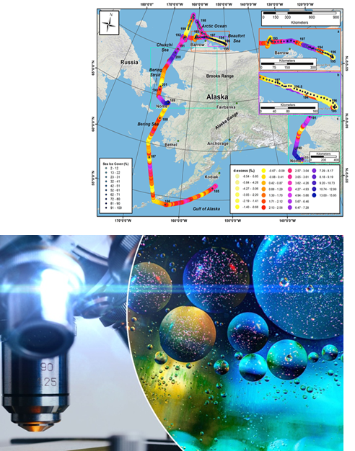
Monitoring Intentional and Unintentional Catastrophic Events: Detecting sea ice and oil spills through measurement of the H2O and C isotope geochemistry in winds.
ADAC Program Year 8 Annual Meeting
Winds of the maritime environment have been continuously monitored as a means of detecting sea ice conditions; vessel emissions and oil spills against a natural background of marine boundary-layer atmospheric chemistry. Research measured water vapor isotopic attributes each second (averaging over 5 min) while transiting from the Gulf of Alaska to the Beaufort Sea on the USCG Healy as well as placed-based station measurements at the Port of Anchorage. Our primary aim is to provide ship or vessel captains real-time data of sea ice conditions (open water, light sea ice, heavy sea ice and total sea ice coverage) that will be displayed at the helm of vessels that are fitted with the detection systems as well as making sea ice conditions estimates available from shore/platform-based systems via a link at the ADAC web site.
Simultaneously, team detected unusual petroleum events in the marine environment, developed a visualization model that will display petroleum (carbon) in the environment across a range of categories (green=ambient/background conditions; yellow=changing conditions; red=extreme changes-i.e. vessel or aircraft emission plume or oil spill plum in the direct vicinity). Our primary findings are that sea ice conditions are reliably reflected in situ on ships as is the presence of aircraft emissions. Shore based systems (Port of ANC) are more complicated and sea ice coverage detection is less reliable, in our case do to the distance (~100 yards) of the measurement system from the ocean.
Winds and seawater of the maritime environment are to be continuously monitored as a means of detecting sea ice conditions, vessel emissions and oil spills against a natural background of marine boundary-layer atmospheric
chemistry. This was accomplished by measuring these attributes while transiting from the Gulf of Alaska to the N
end of the Chukchi Sea (78ºN) on the USCG Healy as well as placed-based stations in Cook Inlet/Port of Anchorage.

Slide 32
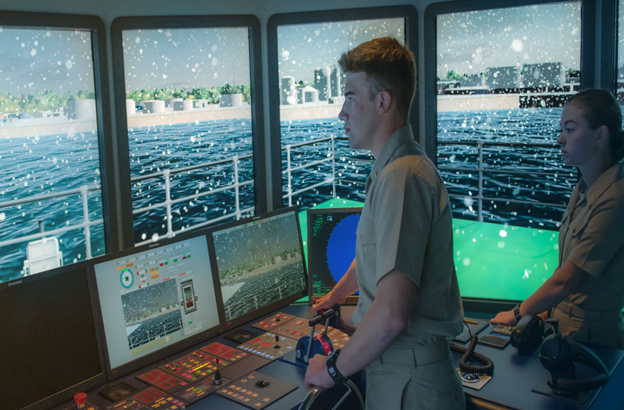
Mariner Ice Navigation Courseware for IMO Polar Code
ADAC Program Year 8 Annual Meeting
This project saw the development of an advanced ice navigation course required by the Polar Code for all masters and chief mates operating in polar waters.
Through this project, a class and simulator was created to teach the basic and advanced ice navigation courses satisfy these requirements for U.S. mariners. Upon completion of these courses, American ship’s officers will have met or exceeded all Standards for Training, Certification, and Watchkeeping (STCW) required by international maritime law.

Slide 33
Next Steps….

Slide 34
Next Steps….Research Ideas and White Papers
ADAC Program Year 8 Annual Meeting
Feasibility Study to assess how Enhanced Port Facilities in the Barrow Area could enhance USCG Operations
Small, scalable and sustainable power generation in support of operation at remote austere locations
GNSS GPS Reflectometry Systems as Remote Telemetered Tide Gauges
Remotely Deployed, Real-Time Ice Freeze-up Detection Buoy for National Weather Service Ince and Weather Forecasting Research
DHS Integrated Negotiation of Critical Infrastructure Threats and Engineering for Resilience (DHS INCITER)
Rapid Assessment of Disease-threats in the Arctic Region (RADAR)
A Rapid Deployment High Frequency Radar for Mapping Surface Currents for Remote Settings
Persistent Human Observation Capability for Offshore Surveillance (PHOCOS)

Slide 35
Ways to Fund ADAC for Project Support:
ADAC Program Year 8 Annual Meeting
Basic Order Agreement (BOA)
Broad Agency Announcement (BAA)
Contract
USACE Cooperative Agreement
CRADA
Grant
Direct Support

Slide 36
Questions?

Slide 37
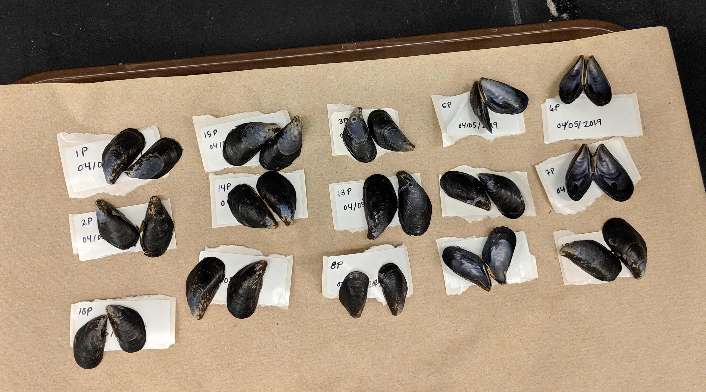
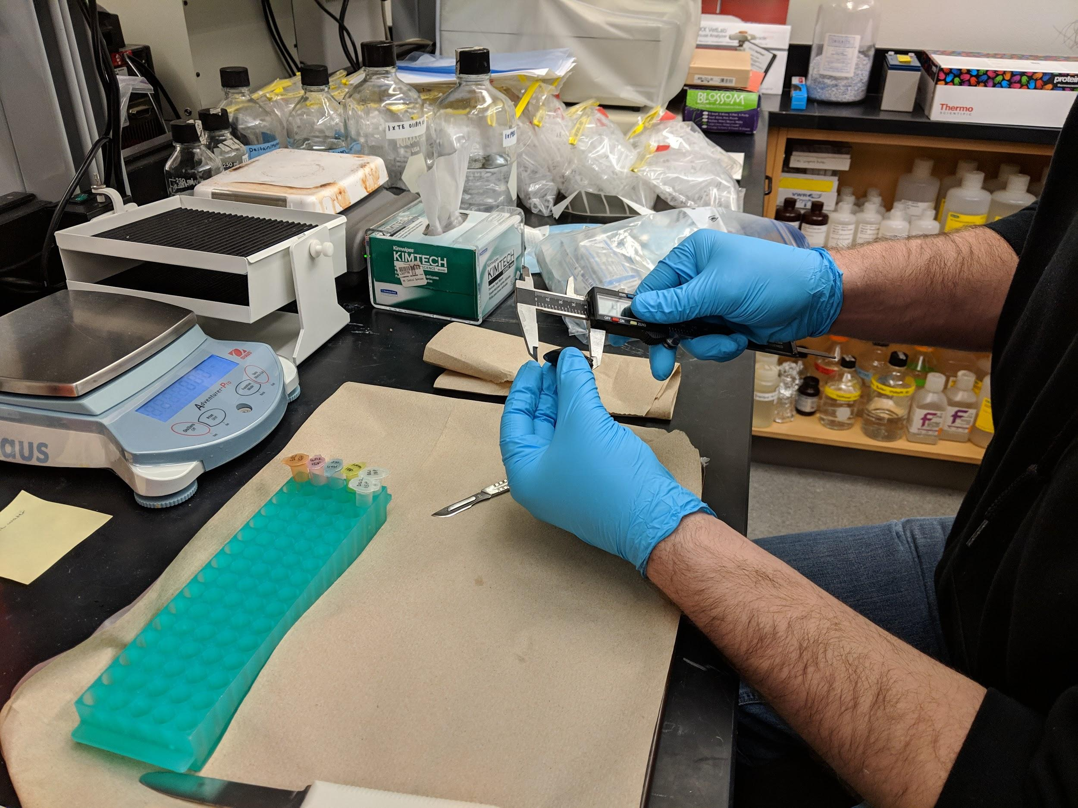

ADAC Year 8 Annual Meeting
ADAC Project Briefing
“Photo-enhanced toxicity of dispersed and burned crude oil to Arctic mussels.”
Patrick Tomco, Ph.D
Department of Chemistry
University of Alaska Anchorage

Slide 38
ADAC Year 8 Annual Meeting
ADAC Project Briefing
“Photo-enhanced toxicity of dispersed and burned crude oil to Arctic mussels.”
Patrick Tomco, Ph.D
Department of Chemistry
University of Alaska Anchorage

Slide 39
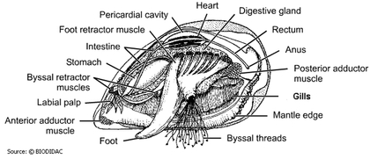
Photo-enhanced toxicity of dispersed and burned crude oil to Arctic mussels
ADAC Program Year 8 Annual Meeting
Project Principal Investigator:
Patrick Tomco, Ph.D
University of Alaska Anchorage
Supporting Team:
Colin McGill, Ph.D, UAA
Katrina Counihan, Ph.D, Alaska Sealife Center
Phoebe Zito, Ph.D, University of New Orleans
Student Participation:
Kevin Fitzpatrick, Anastasia Hanson, and Cameron Carlson
Project Champion:
LTCR Clifton Graham

Slide 40
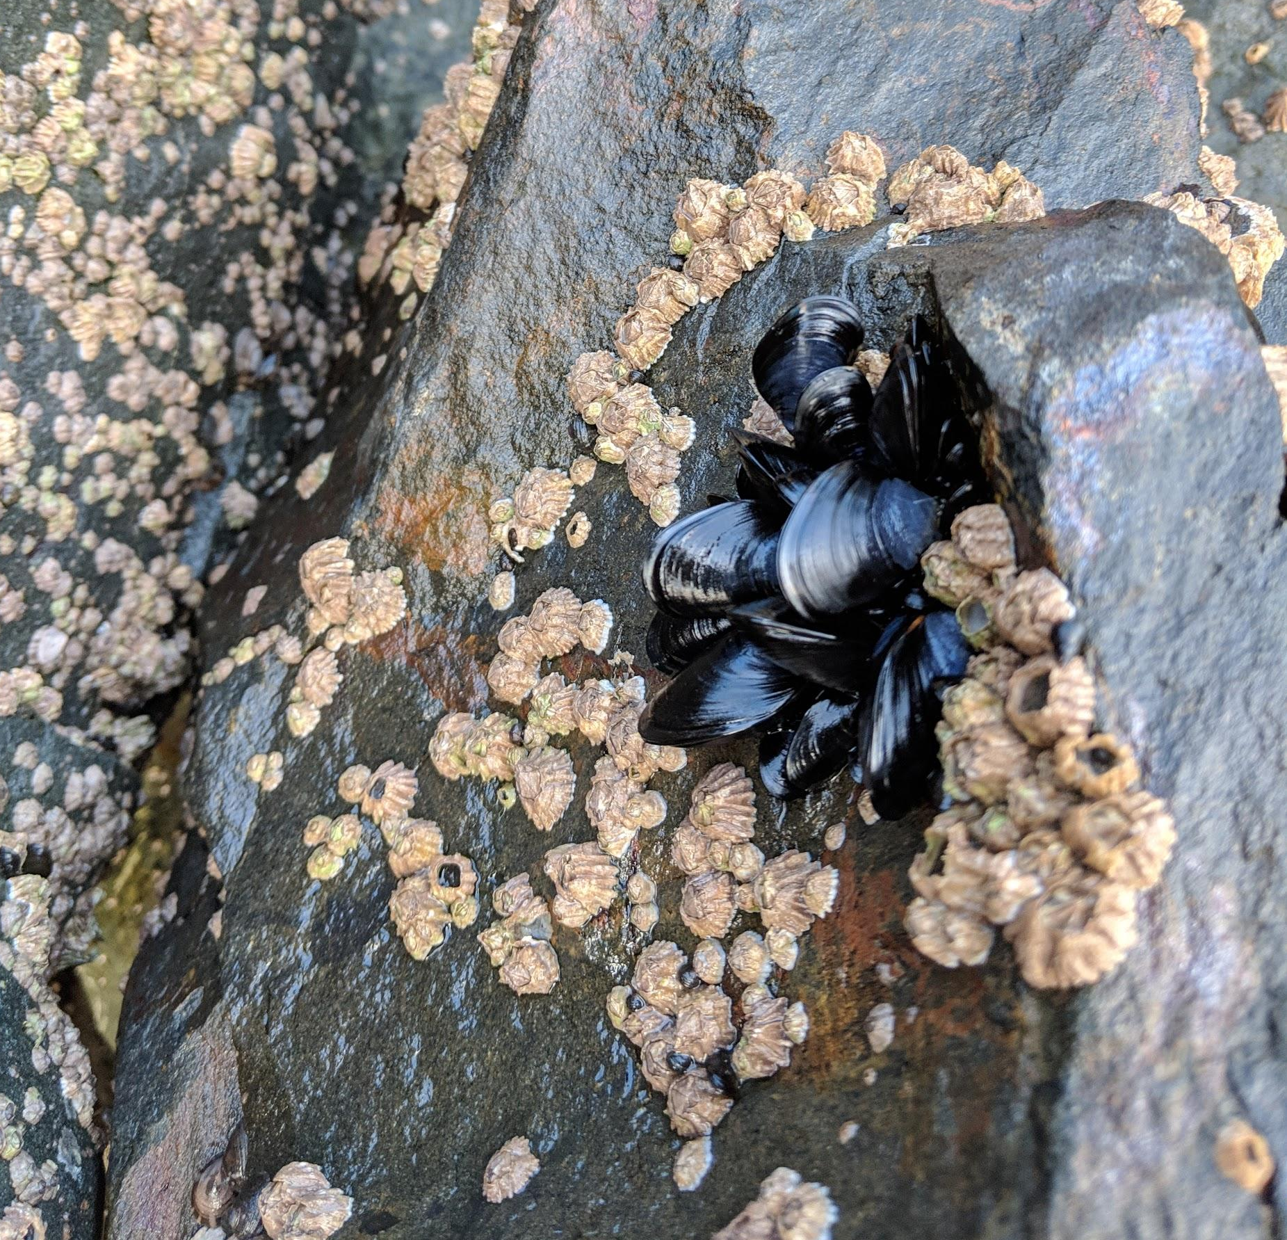
Photo-enhanced toxicity of dispersed and burned crude oil to arctic mussels: Description and Baseline
ADAC Program Year 8 Annual Meeting
Project assesses the impact burned vs dispersed crude oil has on marine life and if seasonal sunlight differences change the efficacy of either recovery method.
The toxicity of dispersed or burned oil to marine organisms can differ from untreated oil
Photo-enhanced toxicity (i.e. the increase in toxicity associated with the presence of sunlight) of crude oil is documented
The toxicological impacts of dispersed vs. burned crude oil exposure in the presence/absence of sunlight toward Arctic mussels have never been assessed in the extreme environmental conditions of the Arctic.

Slide 41
Source: National Academy of Sciences, 2014

Slide 42
Photo-enhanced toxicity of dispersed and burned crude oil to arctic mussels: Relevance
ADAC Program Year 8 Annual Meeting
Relevance to DHS and USCG
Results can be applied to management decisions on the use of recovery methods
A set of knowledge products useful for USCG to apply to a spill response scenario

Slide 43
ADAC Program Year 8 Annual Meeting
Photo-enhanced toxicity of dispersed and
burned crude oil to arctic mussels: Research Objectives
Objective 1: Exposure Experiments
    Conduct static exposure tests with bay mussels in seawater with oil, Corexit 9500, oil dispersed with Corexit 9500, and oil subjected to in-situ burn with three different photoperiods.
Objective 2: Physiological/Biochemical Assays
    Assess physiological and biochemical responses of bay mussels to the oil, dispersant, and in-situ burned oil in the exposure tests at different time points.
Objective 3: Metabolomics
    Evaluate metabolic health of mussels in the exposure tests using metabolomics.
Objective 4: Chemical Analysis
    Profile the chemical constituencies of oil, dispersed oil, and burned oil treatments used in the mussel exposures and how each treatment chemically weathers throughout the experiment.
Objectives incorporated as Phases into timeline

Slide 44



ADAC Program Year 8 Annual Meeting
Progress in meeting research methods:
(Completed Phase 1)
Phase 1 steps:
1. Construct Exposure apparatus
2. Collect Mytilus trossulus from Resurrection Bay
3. Conduct laboratory-based exposure.
  Three exposures completed in September, October, and November

Slide 45
ADAC Program Year 8 Annual Meeting
Milestones from Phase 1 (all complete):
  Team members participated in kick-off meeting with Project Champion
  Team member Counihan (ASLC) constructed exposure chambers in Seward, AK
  Mussels were harvested from Resurrection Bay, AK
  Mussels were acclimated in exposure chambers for 1-2 weeks
  Mussels were dosed with oil, dispersed oil, and burned oil under light and dark conditions.
  Mussels were harvested at 0, 1, 4, and 7 days post-treatment
  Mussels were dissected and tissues archived for Phase 2 and 3
  Water samples were collected and mailed to Team member Zito (UNO).

Slide 46
ADAC Program Year 8 Annual Meeting
Metrics for Phase 1 (all complete)
Metrics for Phase 1:
Task A: Obtain approved State of Alaska Department of Fish and Game aquatic resource permit for hand collection of Mytillus trossulus in Resurrection Bay
Task B: Obtain approved hazardous waste disposal and chemical safety approval.
Task C: Construct 15 exposure chambers. Each capable is suitable for safely containing 50 mussels in 5L seawater and containing oil in the event of a spill.
Task D: Collect >750 mussels from Resurrection Bay suitable for exposure assessment. Transport to exposure chambers.
Task E: Successfully acclimate test organisms to exposure chambers. Record data on mortality. Ensure 50 mussels per exposure chamber are acclimated.
Task F: Successfully collect burn residue from 3 small-scale controlled in-situ burns.
Task G: Expose collected mussels to 5 conditions: seawater, dispersant, oil, dispersed oil, and burned oil) under 3 light regiments. Organisms are harvested on the defined time intervals and dissected with the tissues archived, masses recorded, and recordings of mortality rates.
Completed
Completed
Completed
Completed
Completed
Completed
Completed

Slide 47



ADAC Program Year 8 Annual Meeting
Progress in meeting research methods, Phase 2
Phase 2 (in progress): physiological and biochemical assays
  Hydrogen peroxide formation in hemolymph
  RNA:DNA ratio in mantle
  Cytochrome P450 in digestive gland
  Heat Shock Protein in gill
  Superoxide dismutase in digestive gland
  Micronuclei in gill
  TBARS assay from gills
  ATP/ADP ratio from mantle
  Caspase 3/7 from gills
  Perform Statistical Analysis

Slide 48
ADAC Program Year 8 Annual Meeting
Progress on Milestones – Phase 2
Upon completion of Phase 1, team member Counihan (ASLC) will complete the following analyses (anticipating 1-2 will be complete in ADAC Program Year 5 and 3-6 will complete in ADAC Program Year 6):
  Hydrogen peroxide formation in hemolymph
  RNA:DNA ratio in mantle
  Cytochrome P450 in digestive gland
  Heat Shock Protein in gill
  Superoxide dismutase in digestive gland
  Micronuclei in gill
Upon completion of Phase 1, team member McGill (UAA) will
complete the following analyses (anticipating will be complete in
ADAC Program Year 6):
  TBARS assay
  ATP/ADP ratio
  Caspase 3/7
Completed
Completed
Completed
Completed
Completed
Completed
Completed
Completed
Completed
9 analyses x 750 mussels = 6,750 samples to process!

Slide 49



ADAC Program Year 8 Annual Meeting
Control
Oil
Heat Shock Protein (HSP)
General stress responses to contaminant exposure can be evaluated by measuring heat shock protein 40 (HSP40)
Dispersant
Dispersed Oil
Burned Oil

Slide 50



ADAC Program Year 8 Annual Meeting
Control
Oil
Cytochrome P450
Enzyme that catalyzes reactions involving PAHs and other xenobiotics and can indicate hydrocarbon exposure
Dispersant
Dispersed Oil
Burned Oil

Slide 51

ADAC Program Year 8 Annual Meeting
Control
Oil
RNA : DNA
can be used to determine the metabolic condition of mussels as RNA fluctuates in response to conditions
Dispersant
Dispersed Oil
Burned Oil

Slide 52



ADAC Program Year 8 Annual Meeting
Control
Oil
Superoxide dismutase (SOD)
Antioxidant activity. Evaluates oxidative damage due to the release of reactive oxygen species. Higher ROS is linked to oxidative damage in DNA, protein and lipids. damage
Dispersant
Dispersed Oil
Burned Oil

Slide 53



ADAC Program Year 8 Annual Meeting
Control
Oil
Caspace activity
Cell apoptosis. Programmed cell death, occurs throughout life to maintain cell homeostasis. Activation indicates upregulation of this process.
Dispersant
Dispersed Oil
Burned Oil

Slide 54
ADAC Program Year 8 Annual Meeting
Significant differences observed between the same treatments exposed to the three UV light conditions.
  Mussels exposed to oil or dispersant had the most physiological impacts in 24h and 0h light
  Musssels in dispersed oil and burned oil had more physiological effects in 24h and 12h light
  12h dark conditions.
Numerous significant differences also occurred between different treatments in the same UV lighting
  Dispersed oil generally elicited the strongest responses from the, mussels regardless of light conditions.
Significant differences between time points in each treatment.
  Physiological responses reached a peak at earlier time points in treatments exposed to 12h light: 12h dark UV conditions, while treatments exposed to 0h and 24h UV light peaked at later time points.

Slide 55



ADAC Program Year 8 Annual Meeting
Arctic Mussels Phase 3: progress in meeting research methods
Metabolomics analysis
  extract metabolites
  obtain spectra using 1H NMR 400MHz
  identify peaks using Chenomx software
  statistical anaylsis using PLS toolbox and R

Slide 56
Arctic Mussels Phase 3: Metabolomics
ADAC Program Year 8 Annual Meeting
Metrics for Phase 3:
Task A: Documentation of NMR spectra from tissue extracts.
Task B: Using NMR spectra, identify small molecule metabolites present in tissues based on database matches.
Task C: Statistically compare differences in metabolite profiles between treatments, across time, and between individuals. Tomco to evaluate and quality control the data.
Complete
Complete
Complete

Slide 57
Arctic Mussels Phase 3: Metabolomics
ADAC Program Year 8 Annual Meeting
Milestones for Phase 3:
Metabolites will be extracted from tissues and archived
NMR spectral data will be acquired at the University of Alaska Anchorage NMR facility
Chemical constituencies that correspond to primary metabolites (polar and nonpolar) found in the Human Metabolome Database will be identified
Concentrations of the identified metabolites will be determined
Multivariate statistical analysis (PCA) will be performed on binned NMR spectra (i.e. unsupervised metabolomics)
Complete
Complete
Complete
Complete
Complete

Slide 58


ADAC Program Year 8 Annual Meeting
Results: Metabolomics – All treatments, all light conditions, all time points
Classifier: Photoperiod (light exposure)
Each data point represents all the metabolites found in a single individual.
Differences between 0 & 24 hr, while 12 hr is intermediary

Slide 59

ADAC Program Year 8 Annual Meeting
Results: Metabolomics – All treatments, all light conditions, all time points
Classifier: Exposure duration (time)
Each data point represents all the metabolites found in a single individual.
No difference between the 5 time points

Slide 60





ADAC Program Year 8 Annual Meeting
Results: Metabolomics –All light conditions, all time points, individual examination of treatment
Classifier: Photoperiod (light exposure)
Each data point represents all the metabolites found in a single individual.
Differences between photoperiod for each treatment
Control
Oil
Dispersant
Dispersed Oil
Burned Oil

Slide 61





ADAC Program Year 8 Annual Meeting
Results: Metabolomics –All light conditions, all time points, individual examination of treatment
Classifier: Photoperiod (light exposure)
VIP Scores.
Different metabolites drive the observed variation between treatments
Control
Oil
Dispersant
Dispersed Oil
Burned Oil

Slide 62

ADAC Program Year 8 Annual Meeting
Arctic Mussels Phase 4: Progress in meeting research methods
Phase 4: Profiling chemical constituencies of water-accommodated petroleum and photo-degraded petroleum
  Dissolved Organic Carbon (DOC) Analyses
  Optical Analyses
  Fourier Transform Ion Cyclotron Mass Spectrometry
(McKenna et al. 2013)

Slide 63
ADAC Program Year 8 Annual Meeting
Arctic Mussels Phase 4: Metrics
Completed
Task A: Obtain necessary instrument time permissions for 180 FT-ICR MS samples at the National High Magnetic Field Laboratory.
Task B: Document dissolved organic carbon concentrations in water samples
Task C: Document spectrofluorescence and FT-ICR MS data from water samples.
Task D: Statistically compare differences in DOC, spectrofluorescence and FT-ICR MS data between treatments, across time, and between replicates. Zito to evaluate and quality control the data.
Completed
Completed
Completed

Slide 64
ADAC Program Year 8 Annual Meeting
Arctic Mussels Phase 4: Milestones
Phase 4: Chemical Analyses. Upon completion of Phase 1 and once water samples have been received, Team member Zito will analyze the chemical composition of aqueous-phase hydrocarbons at the University of New Orleans.
Milestones anticipated:
The dissolved organic carbon (DOC) content of each water sample will be calculated
The three-dimensional fluorescence character of each water sample will be determined
Water samples will be pre-concentrated for FT-ICR Mass Spectra collection
FT-ICR MS data will be collected at the National High Field Magnetic Laboratory in Tallahassee FL

Slide 65

ADAC Program Year 8 Annual Meeting
Dissolved Organic Carbon
Measures the total amount of all carbon species dissolved in water

Slide 66

ADAC Program Year 8 Annual Meeting
Component 1
Component 2
Component 3
>95% Database match with petroleum-derived dissolved organic material
Component 5
Fluorescence analysis:
PARAFAC 5 components
Component 4

Slide 67

ADAC Program Year 8 Annual Meeting
Ultrahigh Resolution Mass Spectrometry

Slide 68

ADAC Program Year 8 Annual Meeting
van Krevelen subtraction plots of treatments with relatively high and low cytochrome P450 activity.

Slide 69
ADAC Program Year 8 Annual Meeting
Arctic Mussels Phase 5: Progress in meeting research methods
Synthesize data and prepare knowledge products
Knowledge product was submitted to USCG on December 15th, 2021
Summarized findings and identified appropriate peer-review journals for submission.
All Team members prepared manuscript and submitted to peer-reviewed scientific journal Aquatic Toxicology
Team members facilitated graduate student mentorship outcome (completed M.S. Thesis)

Slide 70
Arctic Mussels: Schedule and Metrics
ADAC Program Year 8 Annual Meeting
Current year research schedule and milestones:
  Phase 1 – Complete
  Phase 2 – Complete
  Phase 3 – Complete
  Phase 4 – Complete
  Phase 5 – Complete
Current year metrics:
Progress on Phase 5

Slide 71
Arctic Mussels: Key Accomplishments
ADAC Program Year 8 Annual Meeting
Key accomplishments of the project:
  Permits obtained
  Engagement with Project Champion
  Exposure chamber build-out
  Mussel harvest
  Exposures conducted
  Tissues dissected
  Samples distributed
  Toxicity data collected and analyzed
  Water samples processed
  Students trained
  Knowledge product created
  Peer-reviewed scientific journal manuscript submitted

Slide 72
Arctic Mussels: Key Findings
ADAC Program Year 8 Annual Meeting
Sunlight exposure significantly affects the toxicity of crude oil, dispersed oil, and burned oil to marine biota
  Most significant = HSP, CP450, Metabolic phenotypes
Timing/magnitude affected both by photoperiod and treatment
Dispersed oil in general = highest toxicity (but burned oil significant too)
More streamlined water chemistry measures of oxidized water-soluble oil are a significant challenge and a priority research need
Mussels are an excellent test organism for this line of study.

Slide 73
Arctic Mussels: Transition Plans
ADAC Program Year 8 Annual Meeting
Future integration with copepods team for knowledge product?
Translating toxicity data generated into policy decisions and criteria for recovering spilled oil requires not only controlled experiments conducted under simulated realistic scenarios and complex data analysis; it also requires a “global perspective” cost/benefit weighing.

Slide 74





Ready for questions…Thank you!
ADAC Program Year 8 Annual Meeting
Notes:
Thank you for the gift of your time and attention.

Slide 75




ADAC Annual Meeting
Marine IP - Detection and Mapping of Oil Under Ice: A Ruggedized Field Kit
PI Dr. Scott Socolofsky, Texas A&M University
Researcher Kari Walker, IntelliSense Marine LLC

Slide 76
ADAC Annual Meeting
Marine IP - Detection and Mapping of Oil Under Ice: A Ruggedized Field Kit
PI Dr. Scott Socolofsky, Texas A&M University
Researcher Kari Walker, IntelliSense Marine LLC

Slide 77
ADAC Project: Marine Induced Polarization Methods for the Detection and Mapping of Oil in an Arctic Marine Oil Spill – Ruggedized Field Kit Production and Testing
ADAC Annual Meeting: 21 April 2022
• Project Principal Investigator: Dr. Scott Socolofsky, Texas A&M University
• Supporting Team:
  Ms. Kari Walker and Mr. Kevin Hand, IntelliSense Marine
  Mr. Art Wright, Mr. Jay Radler and Mr. Todd Stedman, Induced Polarization Associates
  Mr. Nathan Lamie, Lead Engineer/Facility Operator, Cold Regions Research and Engineering Laboratory, U.S. Army Corps of Engineers
• Project Champion: LCDR Clifton Graham, CG-MER

Slide 78

Marine IP: Project Description and Baseline
ADAC Annual Meeting: 21 April 2022
Project Description: Federal on-scene spill responders need remote sensing tools to detect and map oil in the open-Arctic ocean, broken ice fields, as well as oil under and within ice.
This research effort will build and test hardware and software for an Arctic-Ready Marine Induced Polarization (Marine IP) System, which locates and assesses polarizable mineral and particle distributions - such as hydrocarbons - in water, ice and in sediment.
Baseline: Marine IP has shown strong promise to serve as a tool for the detection and mapping of oil under ice and in seafloor sediment. A robust, Arctic-Ready Marine IP system needs to be developed to mitigate the harsh conditions of the Arctic.

Slide 79
Marine IP: Method
ADAC Annual Meeting: 21 April 2022
Oil on and within seafloor sediment:
A cable is towed behind a vessel
Transmit electrodes emit a controlled electrical current
Receiver electrodes measure changes in the return signal caused by substances encountered
Oil
Transmit Electrodes
Receiver Electrodes
Depressor

Slide 80

Marine IP: Method
ADAC Annual Meeting: 21 April 2022
Oil-Under-Ice testing: CRREL Testing Facility
A cable streamed under tank ice
Transmit electrodes emit a controlled electrical current
Receiver electrodes measure changes in the signal due to substances encountered
Transmit (red) and receive (green) electrodes
Induced Polarization Streamer Tail
Induced Polarization Streamer Tail
Buoys (yellow) provide flotation
Control line
Test Area
Test Area
Test Area
Water at 0.25 Salinity

Slide 81

Marine IP: Method
ADAC Annual Meeting: 21 April 2022
CRREL Testing Facility
Oil-Under-Ice testing: CRREL Testing Facility:
Study design included 6 test scenarios:
  Oil under solid ice
  Oil encapsulated within ice
  Oil in pockets under broken and refrozen ice.
  Oil in broken ice
  Controls: Broken ice and solid ice, no oil added
Transmit (red) and receive (green) electrodes
Induced Polarization Streamer Tail
Buoys (yellow) provide flotation
Control line
Test Area
Test Area
Test Area
Water at 0.25 Salinity

Slide 82




Marine IP: Progress on Research Objectives
ADAC Annual Meeting: 21 April 2022
Project Objectives:
Continue to validate Marine IP as a viable means to detect oil within ice and broken ice. Complete
Develop and build the hardware, firmware and software for an Arctic-Ready Marine IP System that can withstand the harsh environment of the Arctic: Complete
Test the Arctic-Ready Marine IP System in an offshore, towed scenario: Complete
Test the Arctic-Ready Marine IP System in a simulated Arctic environment scenario (CRREL): Complete
Further identify possible Marine IP deployment mechanisms for characterization, with emphasis on AUVs: Complete
Old Enclosure
New Enclosure

Slide 83





Marine IP: Progress on Milestones
ADAC Annual Meeting: 21 April 2022
Project Milestones – Hardware Designed and Built
  Fabricate prototype. Complete
Custom build of electronic boards complete.
Design.
Build.

Slide 84



Marine IP: Progress on Milestones
ADAC Annual Meeting: 21 April 2022
New Marine IP Enclosure
  Fabricate prototype. Complete
Marine IP Cable
Laptop
GPS

Slide 85




Marine IP: Progress on Milestones
ADAC Annual Meeting: 21 April 2022
Design and write prototype firmware. Complete
Firmware developed and undergoing small-scale laboratory tests and bug fixes. Complete
Display Interface: Design
Display Interface: Build

Slide 86


Marine IP: Progress on Milestones
ADAC Annual Meeting: 21 April 2022
Project Milestones – Software Design Complete
Engineering report outlining requirement and specification details. Complete
Develop a plan-design-implement-test-revise loop. Complete
Select a suite of core usage and testing cases. Complete
Design.

Slide 87



Marine IP: Progress on Milestones
ADAC Annual Meeting: 21 April 2022
Project Milestones – Software Build Complete
Mock-up a user interface and menu structure. Complete
Complete mockups of user interfaces and software control systems. Complete
Build.
Design.

Slide 88

Marine IP: Progress on Milestones
ADAC Annual Meeting: 21 April 2022
Submit engineering report reviewing design, fabrication methods, construction, and initial performance reviews of hardware system. Complete

Slide 89






Marine IP: Progress on Milestones
ADAC Annual Meeting: 21 April 2022
Startup and initial performance and function tests. Complete
Complete performance and functional tests in laboratory. Complete

Slide 90


Marine IP: Progress on Milestones
ADAC Annual Meeting: 21 April 2022
Hardware: Beach testing of device and its integrations with the Marine IP cables. Complete

Slide 91

Marine IP: Progress on Milestones
ADAC Annual Meeting: 21 April 2022
Submit Field Test Plans for HQ USCG Project Champion review and approval. April 2022
  Demonstration planned for May 2nd with
  Coast Guard LCDR Clifton Graham and
  a NOAA representative in attendance.

Slide 92





Marine IP: Progress on Milestones
ADAC Annual Meeting: 21 April 2022
Complete implementation of Arctic-Ready Marine IP System – Hardware, Software. Complete

Slide 93




Marine IP: Progress on Milestones
ADAC Annual Meeting: 21 April 2022
Complete Field Trials of Arctic-Ready Marine IP System. Complete
Complete data analysis and reporting. April 30

Slide 94
Marine IP: Progress on Outcomes/Outputs
ADAC Annual Meeting: 21 April 2022
  Provide test plan for Arctic-Ready Marine IP System. Complete
Engineering Design Report: Provide advanced information for the design parameters for applications of Marine IP with an autonomous underwater vehicle (AUV). Complete
Arctic-Ready Marine IP System – Hardware: Provide a Marine IP measurement field kit designed for use in arctic conditions. Complete
Arctic-Ready Marine IP System – Software: Provide a new software interface for data collection using the Marine IP measurement field kit. Complete
Technical Report: Provide DHS with a report with all the results of this research that becomes publicly available. April 30
Peer-Reviewed Publications: Research team will produce draft peer-reviewed scientific publications from this project. Intended
Publicly Available Data: Researchers (in coordination with ADAC) will ensure all releasable data produced during this project is publicly available within 6 months of project conclusion. April 30 `

Slide 95
Marine IP: Student Contributions
ADAC Annual Meeting: 21 April 2022
Students did not contribute to this research
One full-time employee and one part-time employee support this project, driving cable design, build, and testing, as well as supporting data processing and analysis

Slide 96



Marine IP: Update on Transition and TRL
ADAC Annual Meeting: 21 April 2022
The goal of this research is to demonstrate Marine IP technology in a relevant environment to enhance situational awareness for the USCG, DHS and other agencies relating to oil released in open or ice-laden water.
Steps to transition:
Demonstration of value and effectiveness for the USCG and other stakeholders through open water and simulated ice environment testing – ADAC Year 6 research.
Development of commercialized equipment, ruggedized for the Arctic environment – ADAC Year 7-8 research.
Develop a software interface suitable for USCG usage – ADAC Year 7-8 research.

Slide 97

Marine IP: Next Steps…
ADAC Annual Meeting: 21 April 2022
Improved signal clarity
Improved post processing software
Testing range of oils
Autonomous operating system
Configure hardware for AUV and buoy deployment
Test in diverse environments
Test on the U.S. Coast Guard Cutter Healy
Questions?
Project team at CRREL during baseline testing.
From L to R: Karin Messenger (USCG), Scott Socolofsky (TA&M), Dana Tulis (USCG), Alexander Balsley (USCG R&D), Kari Walker (Marine IP), Nathan Lamie (CRREL)

Slide 98
Break
9:45-9:55 AM AKDT
1:45-1:55 PM EDT
ADAC: Research for the Arctic Operator… For Today and For the Future

Slide 99

ADAC Year 8 Annual Meeting
ADAC Project Briefing
Arctic Facilities and Infrastructure Environmental Change Risk Index (ERI)
Dr. Craig Tweedie, University of Texas El Paso
Dr. Matt Calhoun, University of Alaska Anchorage

Slide 100
ADAC Year 8 Annual Meeting
ADAC Project Briefing
Arctic Facilities and Infrastructure Environmental Change Risk Index (ERI)
Dr. Craig Tweedie, University of Texas El Paso
Dr. Matt Calhoun, University of Alaska Anchorage

Slide 101








Core Research Team
ADAC Annual Meeting: 21 April 2022
Research Team
Dr. Craig Tweedie
University of Texas El Paso
Dr. Matt Calhoun
University of Alaska Anchorage
Dr. Ben Jones
University of Alaska Fairbanks
Dr. Molly Grear
Pacific NW National Laboratories
Nagruk Harcharek
Ukpeaġvik Iñupiat Corporation
Kelsey Frazier
ADAC
Caitlynn Hanna
ADAC Undergraduate Fellow (UAF)
Brenda Almanza
ADAC Undergraduate Fellow (UTEP)

Slide 102
Project Advisors & Stakeholders
ADAC Annual Meeting: 21 April 2022
Project Advisors
Tom Douglas, Cold Regions Research and Engineering Laboratory, Ft Wainwright AK
Givey Kochanowski, Alaska Senior Advisor for the U.S. Department of Energy (DOE) Office of Indian Energy, Anchorage, AK
Project Evaluator
Dr. Nancy Kinner, University of New Hampshire, Durham, NH
Project Champion
MSTC Hugo Gaytan, Office of Port and Facility Compliance CG-FAC, Headquarters U.S. Coast Guard, Washington, D.C
MSTC Douglas Furman, Office of Port and Facility Compliance CG-FAC, Headquarters U.S. Coast Guard, Washington, D.C.
Project Stakeholders
Mr. Dan Lawrence, CG-OES, HQ USCG Washington D.C.
CDR Wes James, Office of Marine Environmental Response CG-MER, HQ USCG Washington D.C.
Mr. Shannon Jenkins, Senior Arctic Policy Advisor, CG 5PW, HQ USCG Washington D.C.
Dr. Phil McGillivary, Science Advisor USCG Pac Area, Alameda CA
Mr. Phil Thorne, Arctic Planner, USCG District 17, Juneau, AK
Mr. Mark Everett, USCG District 17, Juneau, AK
LCDR Jereme Altendorf, USCG District 17 Sector Anchorage, AK

Slide 103


Baseline – Geographic Challenges
ADAC Annual Meeting: 21 April 2022
Anchorage → Nome: 540 miles
Anchorage → Kotzebue: 547 miles
(~distance between Washington DC and Atlanta)
Anchorage → Unalaska: 1,172 miles
(~distance between Washington DC and Miami)
USCG regulated facility inspectors are challenged with completing necessary critical inspections of potentially hazardous coastal facilities (such as fuel storage tanks) on an annual basis.
  USCG Sector Anchorage has jurisdiction that covers 5.3 million square miles, and an excess of 35,000 miles of shoreline

Slide 104
Project Focus
ADAC Annual Meeting: 21 April 2022
Alaskan USCG-regulated (under 33CFR154) bulk oil facilities and associated infrastructure that persist on permafrost coastal/riverine landscapes that are susceptible to environmental change, namely:
  bulk oil/fuel facilities and/or piers,
  platforms,
  pipelines and
  loading docks near coastal regions or nearby/adjacent waterways.
Facilities/infrastructure may be horizontal or vertically constructed.
Fuel storage facility in Shaktoolik, Alaska, a USCG regulated facility.
Notes:
-Get number of these from proposal
-all loading docks or those just for fuel
-airports?
-is port of nome a facility – check pic
-add caption for 3 main facilities

Slide 105

Project Outcomes
ADAC Annual Meeting: 21 April 2022
This project will create and publish three knowledge products
Synthesis of published literature, existing data, USCG reporting, and expert opinion.
Develop an “Arctic facilities and infrastructure environmental change” risk index as a USCG decision support tool.
Transition products that can be promulgated to the USCG, stakeholders, and the broader scientific and engineering community.
July 2016: Saskatchewan oil spill
Notes:
-add pics
-align text etc

Slide 106

Milestones & Objectives
ADAC Annual Meeting: 21 April 2022
Task 0: Initiate investigative team
Task 1: Conduct comprehensive literature review and establish comms schedule
Task 2: Formation of project core advisory team
Task 3: Initial meetings of core team and stakeholders
Task 4: Conduct two day virtual conference
Task 5: Establish virtual working groups
Task 6: Conduct two-day workshop to review working group drafts and integrate feedback into knowledge product
Task 7: Completion of Arctic facilities and infrastructure environmental change risk index product.
Task 8: Transition products to USCG community

Slide 107
Challenges & Unforeseen Risk
ADAC Annual Meeting: 21 April 2022
Project start date scheduled for 15 Mar 2021
Kick-off meeting held 30 Apr 2021
Post meeting notice of CAPO review
After second CAPO and IRB approval, start date of 1 Jul 2021
Caused cascading effect related to researcher schedules
Effective working period of Sep 2021 – Feb 2021
Key Outcomes and Takeaways
If CAPO will be employed in future, beneficial to advise teams to add 2-4 additional months to start up timing
Organic project ideation is a unique path for DHS/USCG and show much promise. Recommend investment in ”lessons learned.”

Slide 108
Accomplishments
ADAC Annual Meeting: 21 April 2022
Task 0: Initiate investigative team. Completed
Hosted kick-off in Apr 2021
Significant project delays due to CAPO review
Task 1: Conduct comprehensive literature review and establish comms schedule. Completed.
Project team just concluded research phase on 31 Mar 2022
Knowledge product completed (draft) and under review
Task 2: Formation of project core advisory team. Completed.
Delays meant this milestone was streamlined. Core team and investigative team are the same.
Task 3: Initial meetings of core team and stakeholders. Completed.
Core team met once week during research phase; every two weeks with Project Champion
Task 4: Conduct two-day virtual conference. Completed.
Virtual event held 29/30 Sept 2021
Conference honed focus of project. Produced new data sources.

Slide 109
Accomplishments
ADAC Annual Meeting: 21 April 2022
Task 5: Establish virtual working groups. Completed.
Environmental group: constructed ArcGIS maps of all 394 bulk fuel facilities under USCG regulation. Measured elements like distance bx facility and shoreline.
Engineering group: obtained training data pointing at most significant issues. Determined significant lack of historic data.
Cast Study group: analyzed past spill reports and accidents to determine root cause.
Socio-Environment group: analyzed impacts of spills.
Recommendations from each group included in Knowledge Product.

Slide 110
ADAC Annual Meeting: 21 April 2022
Task 5: Establish virtual working groups
Environmental Change/Susceptibility
Ex: Coastal erosion rates
Ex: Permafrost Type/Thaw rates
Engineering Vulnerability
Ex: Training/Human Factor
Risk Value
Red/Yellow/Green
Weighted based on index rate
Distance to structure
Rebalancing/structural damage
More/less training; documentation, etc.
Ex: Age of Infrastructure
signs and symptoms
Known vs unknown rates
Impact/Mitigation
Ex: Impact to local wildlife, flora, humans
Ex: Mitigation ease vs. complications

Slide 111


ADAC Annual Meeting: 21 April 2022
Task 5: Establish virtual working groups

Slide 112

ADAC Annual Meeting: 21 April 2022
Task 5: Establish virtual working groups
https://dggs.alaska.gov/hazards/coastal/shoreline-change.html

Slide 113
Accomplishments
ADAC Annual Meeting: 21 April 2022
Task 6: Conduct two-day workshop to review working group drafts and integrate feedback into knowledge product
Consolidated. Lack of time reduced ability to meet Task 6. Coordinating feedback with Project Champion and Project Stakeholders independently. Completion scheduled for May 2021.
Task 7: Completion of Arctic facilities and infrastructure environmental change risk index product.
Forthcoming; Draft product underway. Completion scheduled for Apr/May 2021
Task 8: Transition products to USCG community
Forthcoming; handoff scheduled for June 2021

Slide 114
Recommendations & Discoveries
ADAC Annual Meeting: 21 April 2022
Recommendations
Data to transition product from tabletop/theoretical exercise
Integrate forthcoming data from DC/AEA
Provide USCG annual improvements and iterative process
Use risk evaluations to further drive scientific endeavors
Encourage organic project development but with additional support structures
Discoveries
Need a realistic method for integrating data across agencies
Class 2 facilities in Alaska have disparate data sets and no single body maintains this data
Funding – current and future needs
Incentivize bulk fuel personnel who play critical role in prevention

Slide 115

Final Thoughts & Questions
ADAC Annual Meeting: 21 April 2022
~80% of Arctic communities depend on diesel as primary energy source
Coastal communities receive single annual deliveries of fuel by barge in the summer.
Cost per person is locked in based on delivery price.
Emergency deliveries come by air lift
Depending on location, no alternative fuel sources exist
What happens if there’s a spill?
Depends on the season and distance from a “hub” city
Is the spill a result of mechanical failure? Or environmental changes?
The intention of the research team is to enhance energy security and prevent environmental impacts a spill could cause.
Source: World Energy Council, Trilemma Index

Slide 116

Remote Uncrewed Aircraft System (UAS) Inspection and Response Team Development in the Bering Strait Region
Dr. Jessica Garron, Principal Investigator
International Arctic Research Center, University of Alaska

Slide 117
Remote Uncrewed Aircraft System (UAS) Inspection and Response Team Development in the Bering Strait Region
Dr. Jessica Garron, Principal Investigator
International Arctic Research Center, University of Alaska

Slide 118

Land Acknowledgement
ADAC Program Year 8 Annual Meeting 20-21 April 2022
My home and office are located on the traditional land of the Lower Tanana Dene people in an area that is now known as Fairbanks, Alaska. This project will take place on the traditional lands of the Inupiat and Yupik people in an area that is known today as Unalakleet, Alaska.

Slide 119

Remote Unmanned Aircraft System (UAS) Inspection and Response Team Development in the Bering Strait Region
ADAC Program Year 8 Annual Meeting 20-21 April 2022
Principal Investigators
  Dr. Jessica Garron, Research Faculty, International Arctic Research Center, University of Alaska Fairbanks
  John Henry Jr, Deputy Director, Native Village of Unalakleet
  Margy Hall, Associate Director, Model Forest Policy Program
  CDR Jereme Altendorf, USCG Sector Anchorage
Project Champions
  CDR Chad Thompson, USCG HQ
  LCDR John Walters, USCG HQ
Hall and Garron performing site survey at delta of Unalakleet River flowing into Bering Sea. Photo c/o M. DeLue

Slide 120

Remote Uncrewed Aircraft System (UAS) Inspection and Response Team Development in the Bering Strait Region
ADAC Program Year 8 Annual Meeting 20-21 April 2022
NVU UAS Pilots
Katie Daniels
Harry Ivanoff
UAF UAS Pilots
Mike DeLue
Sam Jefries
L to R: Margy Hall (Co-I), John Henry, Jr. (Co-I), Jessica Garron (PI), Katie Daniels (NVU UAS), Harry Ivanoff (NVU UAS), Mike DeLue (UAF UAS), Sam Jeffries (UAF UAS)

Slide 121

Baseline Conditions and Project Relevance
USCG Mission Needs
ADAC Program Year 8 Annual Meeting 20-21 April 2022
Diminished sea ice coverage in Northern oceans allows for more vessel traffic in the Bering Sea.
USCG responders have identified the need for more effective strategies to prevent and address marine disaster response in Western Alaska, and specifically the Bering Strait region.
A critical need exists to improve inspections and inspection frequency of rural bulk fuel facilities across remote regions in the Arctic and Western Alaska.
USCG D17 Sector Anchorage identified staffing challenges, extraordinary logistics and associated costs of travel to remote/off road system rural Alaska,
  363 regulated facilities not on road system requiring inspection; 6 billeted facility inspectors.
Sample bulk fuel storage tank in remote Alaska. Image c/o the Denali Commission

Slide 122

Baseline Conditions and Project Relevance
Unalakleet Community Needs
ADAC Program Year 8 Annual Meeting 20-21 April 2022
Impacts of diminished sea ice coverage in Northern oceans,
More vessel traffic in the Bering Sea
Reduced offshore ice protection
Increased frequency of fall storms
Increased current flow and direction
Changing river conditions are causing,
Early breakup
More turbidity
Increased erosion
Need localized solution for broad situational awareness during emergencies
Search and rescue activities
Oil spill detection and monitoring
Climate change monitoring
A precursor study competed in 2020 by Henry, Garron & Hall, Improving Local Decision Making in Alaskan Communities with Drones and Online Climate Data Tools - A UAS Implementation Feasibility Study Project, identified UAS as a viable tool in support of local decision-making in remote Alaska.
Bering Sea from Unalakleet. Photo c/o J. Garron

Slide 123
Project Rationale and Description
ADAC Program Year 8 Annual Meeting 20-21 April 2022
UAS potentially provide a localized, inexpensive, remote sensing solution, ideal for hazardous and hard to access tasks in remote Alaska.
This project is designed to develop UAS pilot teams in the Bering Strait region in support of decision-making about infrastructure status and emergency response activities. This work includes the remote training and certification of 7 members of the Unalakleet community to be UAS pilots, the coproduction of bulk fuel infrastructure assessment and emergency response UAS protocols, inclusive of remote data delivery investigations, the feasibility of expanding this training program regionally, and the broad dissemination of knowledge gained to other remote Arctic communities interested in applying UAS technology to local decision-making.

Slide 124

Remote Uncrewed Aircraft System (UAS) Inspection and Response Team Development in the Bering Strait Region: Methodology
ADAC Program Year 8 Annual Meeting 20-21 April 2022
Scenario-based research design
Community needs
USCG mission
UAS applications

Slide 125

Methodology
ADAC Program Year 8 Annual Meeting 20-21 April 2022
Sequenced methodology is oriented to,
Provide UAS pilot training of rural residents,
Establish co-production of infrastructure assessment operational UAS protocols,
Establish co-production of emergency assessment UAS protocols,
Conduct information dissemination,
Provide regional expansion feasibility analysis.

Slide 126
Remote Uncrewed Aircraft System (UAS) Inspection and Response Team Development in the Bering Strait Region: Schedule and Metrics
ADAC Program Year 8 Annual Meeting 20-21 April 2022
Task 1: UAS Pilot Training and Certification
Task 2: Coproduction of Infrastructure Inspection Operational Protocols
Task 3: Coproduction of Emergency Response Assessment Protocols
Task 4: Regional Expansion Feasibility Assessment
Task 5: Information Dissemination
June 2021
April 2022

Slide 127
Primary Tasks and Objectives
July 1, 2021 - March 31, 2022
ADAC Program Year 8 Annual Meeting 20-21 April 2022
Task 0 – Project Coordination
Program establishment,
Conduct team coordination meetings – internal/external (on-going),
Reporting (on-going).
Task 1 – UAS Pilot Training and Certification
Recruit UAS pilot teams,
Deliver remote UAS pilot training,
Acquire operational UAVs, sensors and software,
Support FAA certification of UAS pilots,
Deliver on-site UAS flight training.
Task 2 - Coproduction of Infrastructure Inspection Operational Protocols
Determine current tank and fuel delivery infrastructure inspection requirements,
Coproduce a UAS-based tank and fuel delivery infrastructure inspection protocol,
Perform infrastructure inspection flights and product delivery tests.
Task 3 - Coproduction of Emergency Response Assessment Protocols
Determine key community assets for monitoring pre/post emergency response,
Coproduce emergency response UAS protocol based upon surveys of key community assets,
Perform emergency response baseline flights and product delivery tests.
Task 4 – Regional Expansion Feasibility Assessment
Summarize key (local and regional) documents for critical infrastructure and emergency response information,
Develop regional contact list and conduct regional UAS survey.
Finalize Assessment.
Task 5 - Knowledge Product Development Information Dissemination
Create USCG-focused Knowledge Product (on-going),
Engage non-technical stakeholders (locally, regionally, nationally) (on-going),
Develop and submit publication about sensor capacity testing and general inspection methodology to technical journal.
On-going work
Completed work
Upcoming work

Slide 128


Remote Uncrewed Aircraft System (UAS) Inspection and Response Team Development in the Bering Strait Region: Task 1 – UAS Pilot Training and Certification
ADAC Program Year 8 Annual Meeting 20-21 April 2022
Recruit UAS pilot teams (ADAC Y7),
Deliver remote UAS pilot training (ADAC Y7),
  Mondays from 1300-1500 AKDT via Zoom,
  Recordings via YouTube, FB, and email,
Acquire operational UAVs, sensors and software,
Support FAA certification of UAS pilots,
Deliver on-site UAS flight training.
Above: Hands-on training November 2021;
Right: Dueling drones during equipment testing.

Slide 129

ADAC Program Year 8 Annual Meeting 20-21 April 2022
Remote Uncrewed Aircraft System (UAS) Inspection and Response Team Development in the Bering Strait Region: Task 1 – UAS Pilot Training and Certification
Skydio
Designed, assembled and supported in the USA
  2D scan for linear and area mapping
  3D scan for infrastructure inspections
  360° obstacle avoidance via AI powered autonomy
S2 – Training/operational aircraft with electro-optical sensor
X2E - Operational aircraft with electro-opticl and longwave infrared (thermal) sensors
The Skydio Fleet - X2E with electro-optical and infrared sensors, X2E with electro-optical sensor, S2 with electro-optical sensor. Photo c/o R. Marlowe, AKDOT.

Slide 130


ADAC Program Year 8 Annual Meeting 20-21 April 2022
3D Mapping

Slide 131

Remote Uncrewed Aircraft System (UAS) Inspection and Response Team Development in the Bering Strait Region: Task 2 - Coproduction of Infrastructure Inspection Operational Protocols
ADAC Program Year 8 Annual Meeting 20-21 April 2022
Determine current tank and fuel delivery infrastructure inspection requirements,
Coproduce a UAS-based tank and fuel delivery infrastructure inspection protocol ,
Perform infrastructure inspection flights and product delivery tests.
Unalakleet tank farm test flight with X2E flown by K. Daniels. Photo c/o J. Garron

Slide 132


ADAC Program Year 8 Annual Meeting 20-21 April 2022
M. DeLue
NVU UAS pilot K. Daniels and Skydio trainer J. Garcia flying a 3D scan during on-site flight training.

Slide 133



ADAC Program Year 8 Annual Meeting 20-21 April 2022
Remote Uncrewed Aircraft System (UAS) Inspection and Response Team Development in the Bering Strait Region: Task 2 - Coproduction of Infrastructure Inspection Operational Protocols
Sample of simple change detection of 2D map of Unalakleet water supply pump house. Images captured and processed by K. Daniels using DroneDeploy.

Slide 134

Remote Uncrewed Aircraft System (UAS) Inspection and Response Team Development in the Bering Strait Region: Task 3 - Coproduction of Emergency Response Assessment Protocols
ADAC Program Year 8 Annual Meeting 20-21 April 2022
Determine key community assets for monitoring pre/post emergency response,
Coproduce emergency response UAS protocol based upon surveys of key community assets,
Perform emergency response baseline flights and product delivery tests.
Image courtesy of skycoreaviation.com

Slide 135

Remote Uncrewed Aircraft System (UAS) Inspection and Response Team Development in the Bering Strait Region: Task 4 – Regional Expansion Feasibility Assessment
ADAC Program Year 8 Annual Meeting 20-21 April 2022
Summarize key (local and regional) documents for critical infrastructure and emergency response information,
Develop regional contact list and conduct regional UAS survey,
Finalize assessment.

Slide 136

Remote Uncrewed Aircraft System (UAS) Inspection and Response Team Development in the Bering Strait Region: Task 5 - Knowledge Product Development & Information Dissemination Products & Publications
ADAC Program Year 8 Annual Meeting 20-21 April 2022
Create USCG-focused Knowledge Product,
Engage non-technical stakeholders (locally, regionally, nationally) (on-going),
  FB page for pilot blogging and Q&A
  All recordings from YouTube
  Quarterly Newsletters
  Interviews – Radio, TV, Press Releases
Develop and submit publication to peer reviewed journal.

Slide 137

Remote Uncrewed Aircraft System (UAS) Inspection and Response Team Development in the Bering Strait Region: Task 5 - Knowledge Product Development & Information Dissemination Presentations
  ADAC YR7 presentations
  UNK Search and Rescue
  Innovations in Climate Resilience (Battelle)
  UNK City Council
  Alaska Forum on the Environment
  Alaska Tribal Resilience Learning Network
  International Circumpolar Remote Sensing Symposium

Slide 138

ADAC Program Year 8 Annual Meeting 20-21 April 2022
Beyond Unalakleet...
Regional Expansion Feasibility Analysis in Support of Transition Planning
Investigate long-term & regional implementation strategies.
Identify, assess, and prioritize critical infrastructure, vulnerable community assets, and emergency response scenarios for UAS support.
Outreach to local, regional and federal entities (e.g. IGAP coordinators, public works staff, emergency responders and communications technicians) for critical input.
Develop NVU UAS contracting mechanisms.
Integrate key findings into USCG Knowledge Product.
Report findings.
Photo c/o M. DeLue

Slide 139

Remote Uncrewed Aircraft System (UAS) Inspection and Response Team Development in the Bering Strait Region: Research Outcomes
ADAC Program Year 8 Annual Meeting 20-21 April 2022
A knowledge product for the USCG as a use case for other areas/applications
A developed set of SOPs and operational UAS protocols for,
  Infrastructure Inspection
  Oil Spill Detection
  Flood Delineation
  Search and Rescue Support
Establishment of a Norton Sound/Bering Strait regional UAS team for USCG mission support
Bering Strait regional feasibility assessment for UAS program implementation
Photo c/o J. Garron

Slide 140

Impacts and Applications
UAS enhanced support of...
FEMA Hazard Mitigation Plans
State of Alaska DHS&EM Small Community Emergency Response Plans (SCERP)
Local infrastructure monitoring capacity and fund acquisition
USCG regional inspection support
USCG regional emergency response
Arctic security - surveillance
State of Alaska DOT asset integrity - Runways, roads, bridges
Bering Strait regional energy planning processes
Bering Strait economic development plans
Sample SCERP

Slide 141
Remote Uncrewed Aircraft System (UAS) Inspection and Response Team Development in the Bering Strait Region
Dr. Jessica Garron
jigarron@alaska.edu
Thank You
Notes:
Thank you for the gift of your time and attention.

Slide 142
Closing Remarks with Former Executive Director Randy “Church” Kee and Collaboration Forward
ADAC Year 8 Annual Meeting, 20-21 April
Randy “Church” Kee, Maj Gen, USAF (Ret), Senior Advisor, Arctic Security Affairs, Ted Stevens Center for Arctic Security Studies, US Department of Defense
ADAC: Research for the Arctic Operator… For Today and For the Future

Slide 143
Conclusion of ADAC’s Program Year 8 Annual Meeting
ADAC Year 7 Annual Meeting, 2-3 June 2021
Thank You
ADAC: Research for the Arctic Operator… For Today and For the Future

Slide 144
Break
The Annual Meeting will reconvene @
9:55 AM AKDT
1:55 PM EDT
ADAC: Research for the Arctic Operator… For Today and For the Future

Slide 145
Oops! We are experiencing technical difficulties
The Annual Meeting will reconvene shortly
We appreciate your patience as we resolve this issue
ADAC: Research for the Arctic Operator… For Today and For the Future

